Slide 1
Welcome to the
physics phun club!
Jenny Zhang

Slide 2
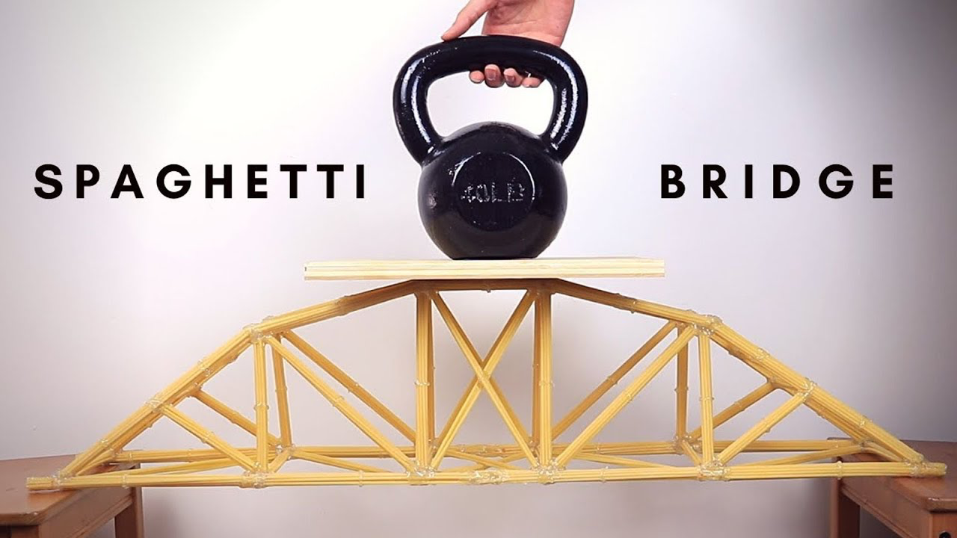
Things we will do this year…
Atmosphere pressure
Electricity and magnetism
Energy and heat
Chemical reactions
Spaghetti bridge?
Physics Bowl!
Coach lower & middle school student?
…

Slide 3
AIR PRESSURE

Slide 4
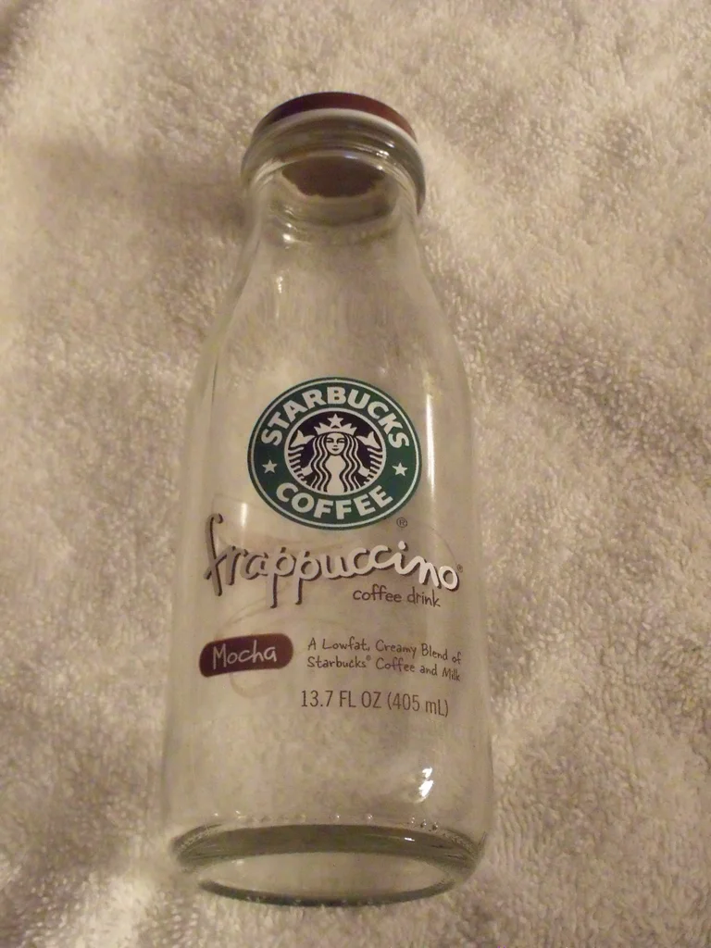
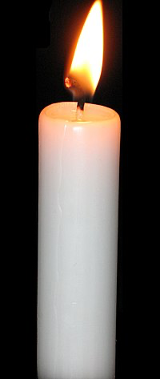
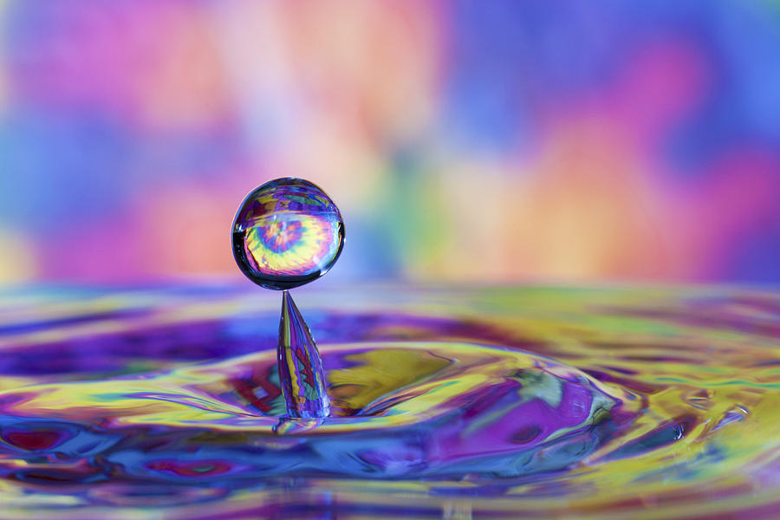

Slide 5
Why did the water still go up after the flame went out?

Slide 6
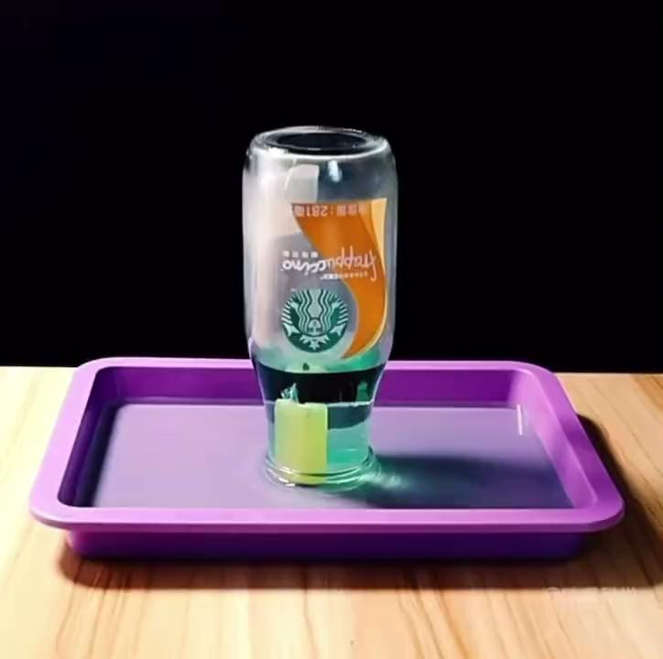

Slide 7
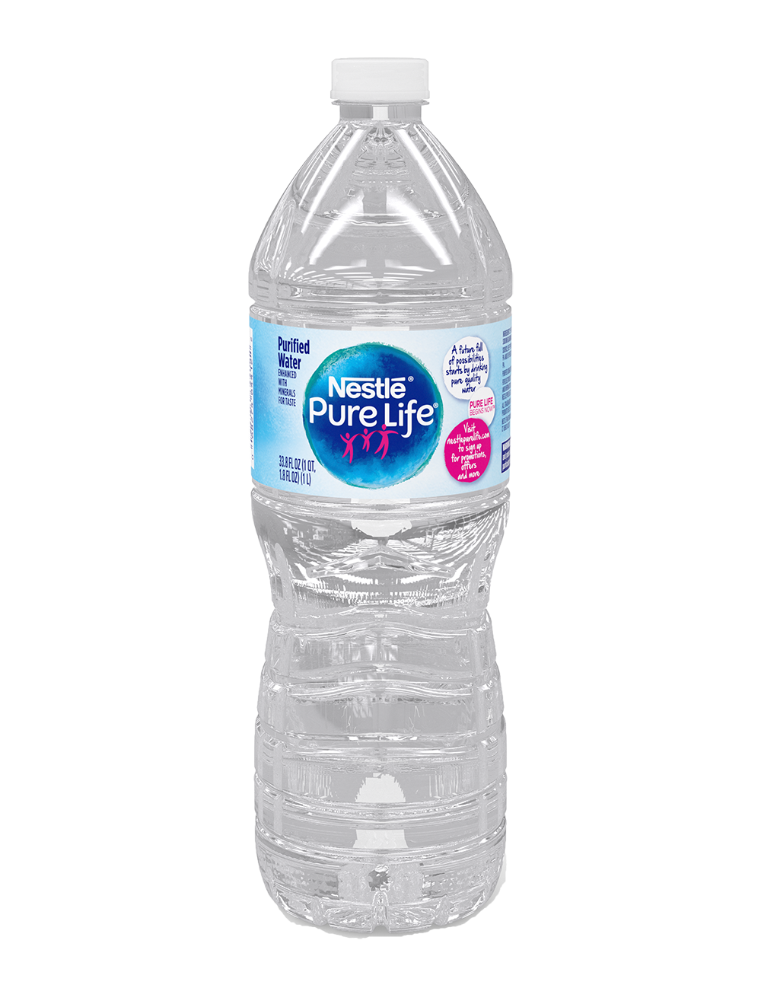
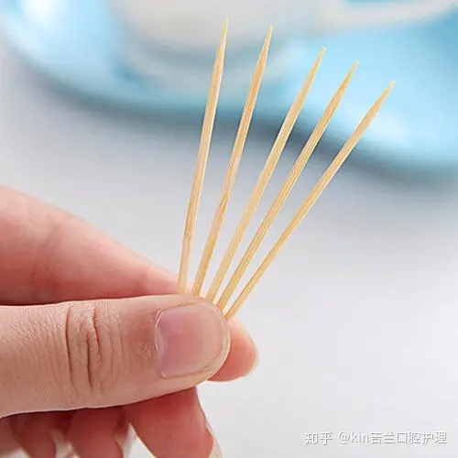
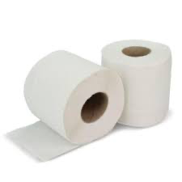

Slide 8
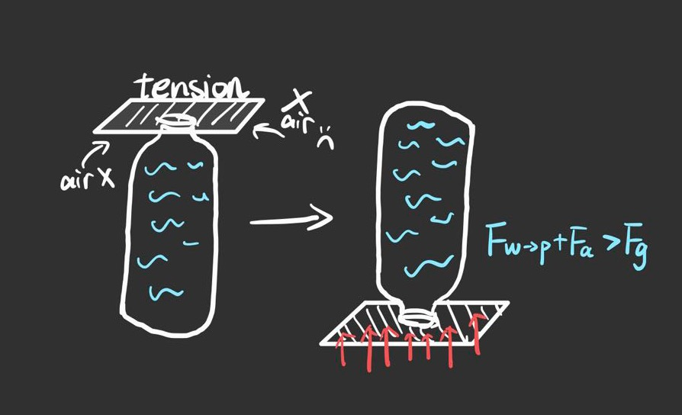

Slide 10
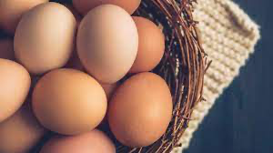
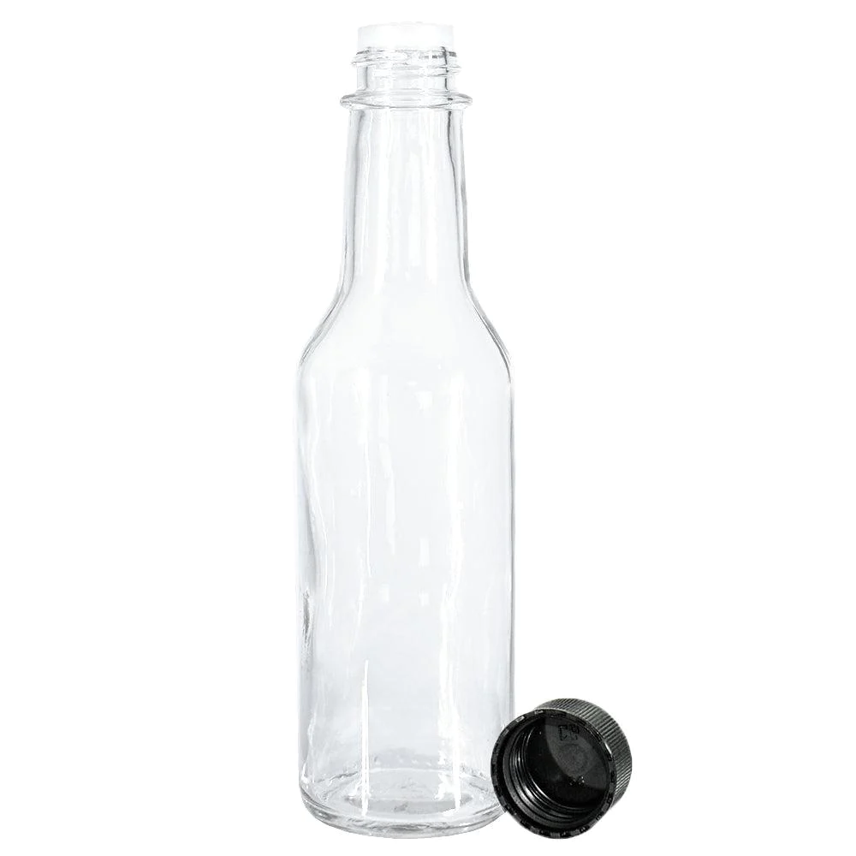
Boiled egg

Slide 11
Oxygen is CONSUMED by the flame…
The outside atmospheric pressure pushes the egg…
The egg falls!

Slide 12
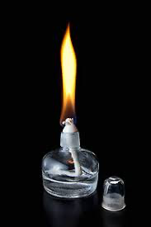
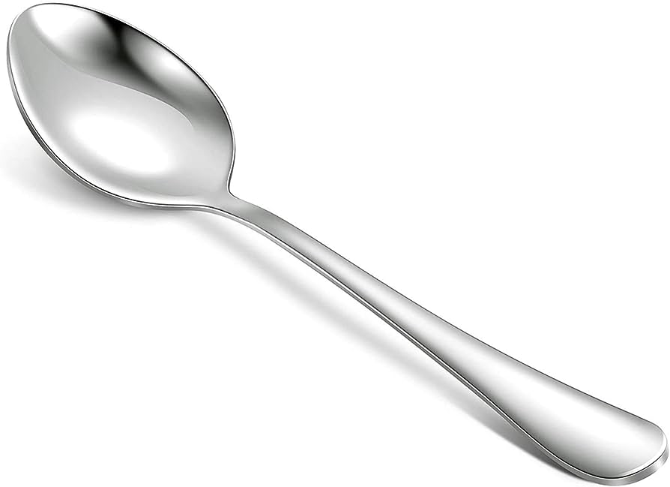

Slide 13
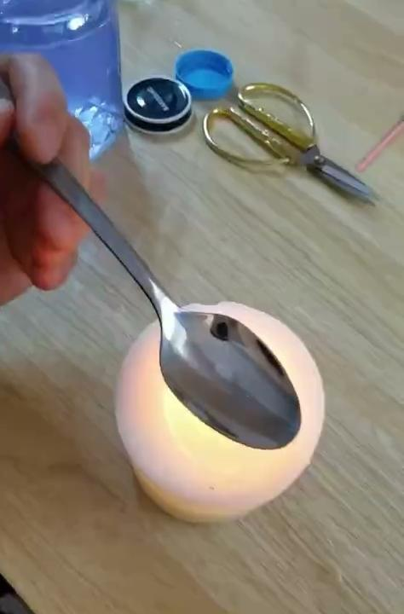

Slide 14
Thanks!

