Slide 1
Welcome to the
Physics Phun Club!

Slide 2
Heat transfer

Slide 3
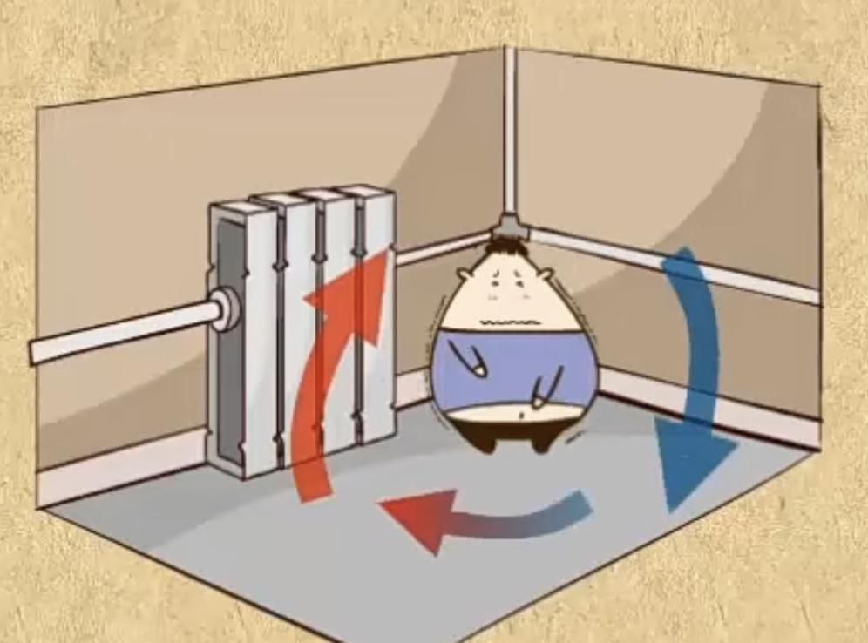
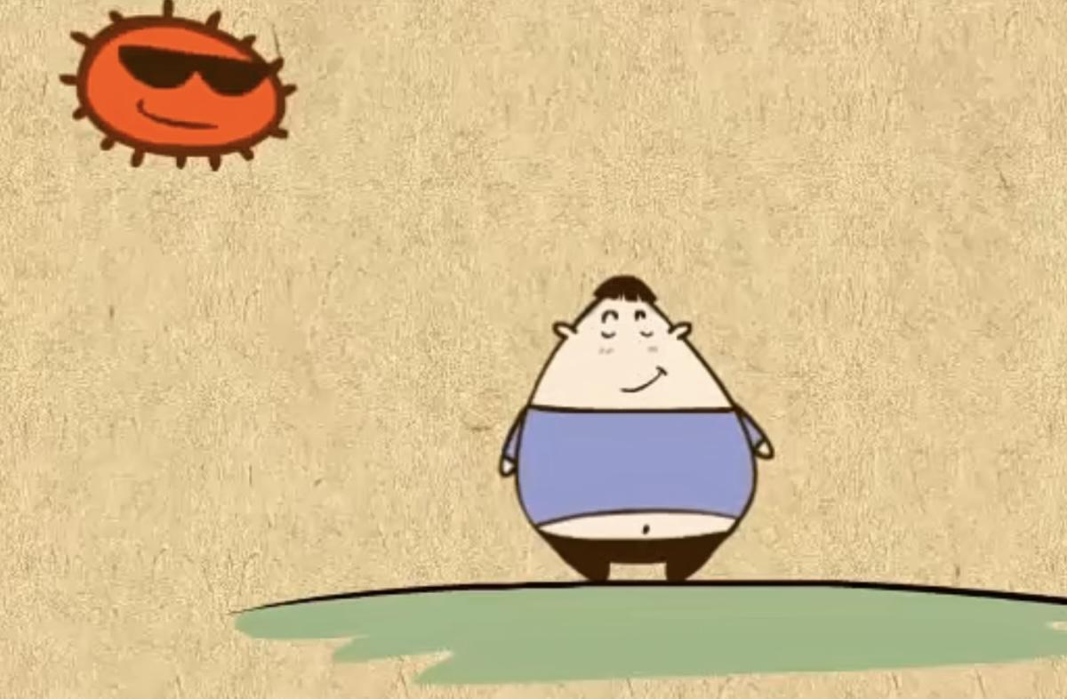
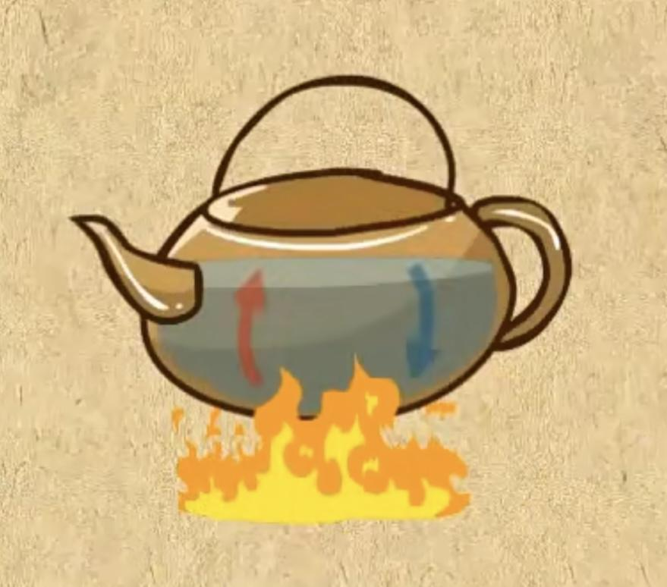
Heat transfer
An object with higher temperature
An object with lower temperature
heat
Thermal Conduction Thermal Convection Thermal radiation

Slide 5
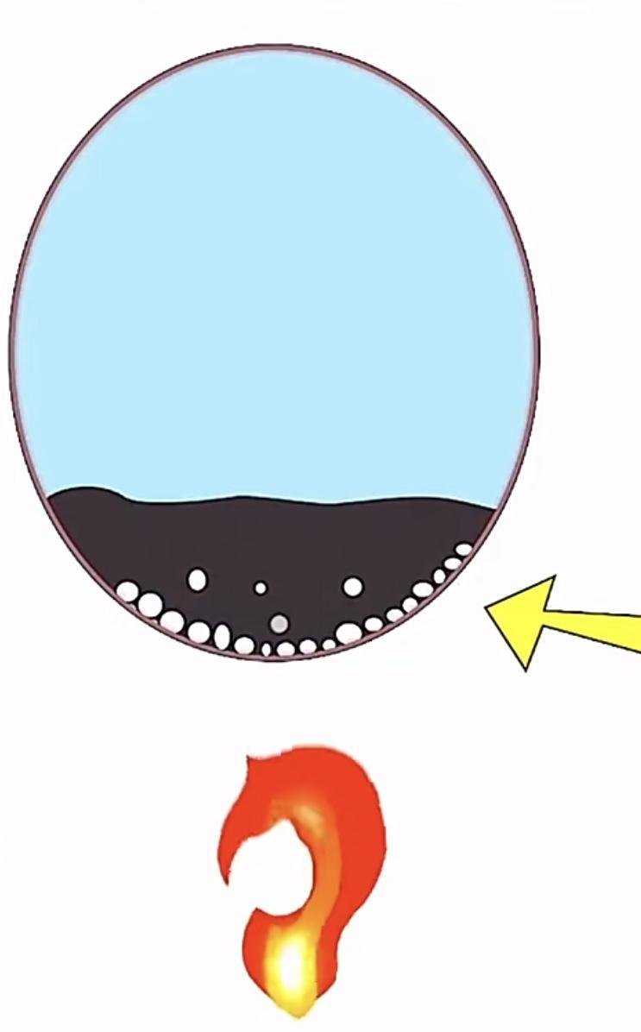
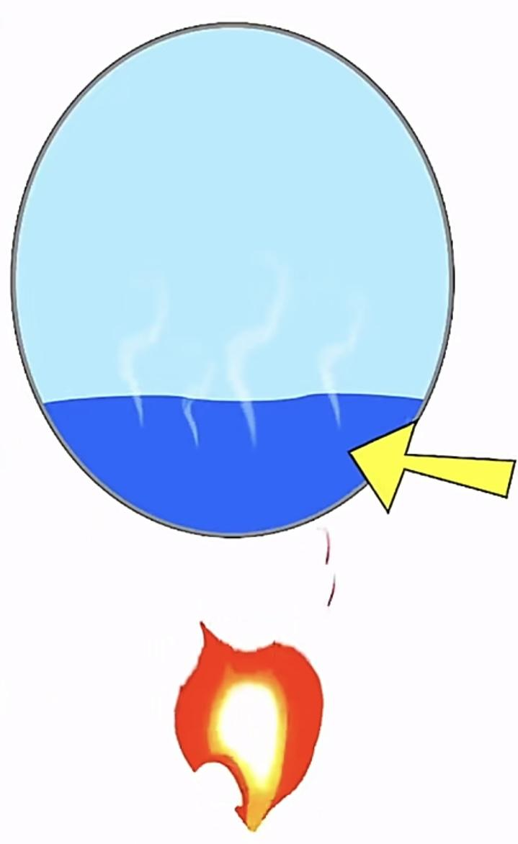
Water: high heat capacity
The temperature of the balloon did not reach the melting point

Slide 6
The full experiment:
https://www.youtube.com/watch?v=qeDZQ9-gsjY

Slide 7
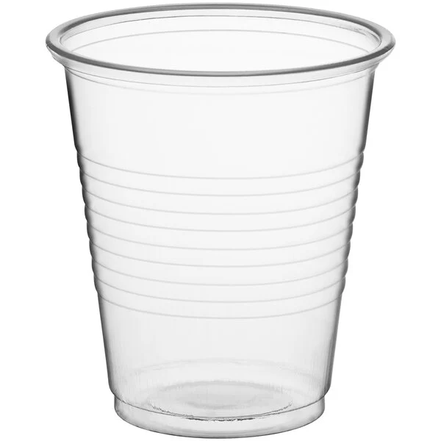
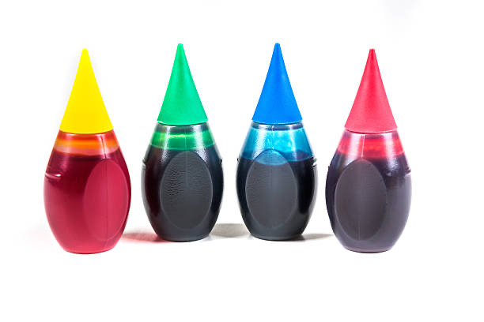
✕ 2
A cup of warm water + A cup of cold water

Slide 8
The water molecules in cold water move slowly and have a high density
The water molecules in hot water move quickly and have a low density (the volume of an object expands when heated, and the density becomes smaller)

Slide 9
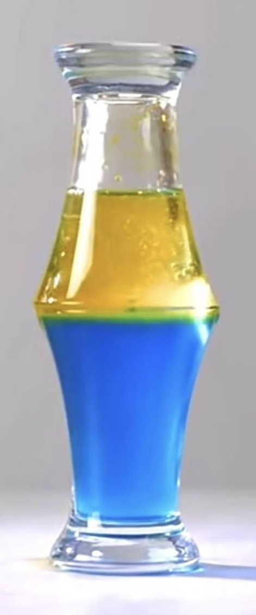
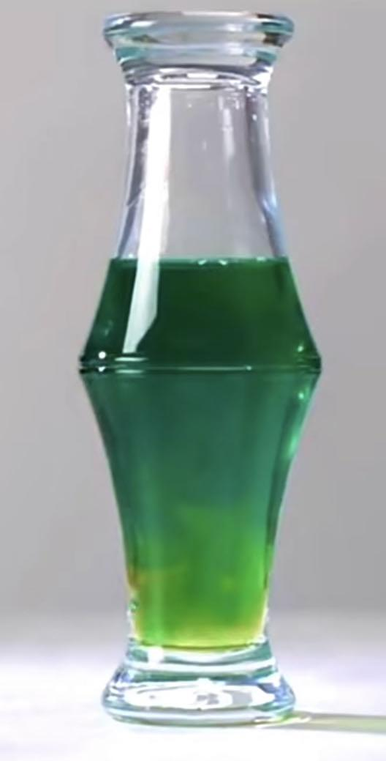
Hot water on cold water
Cold water on hot water
Low density
High density
low density
High density

Slide 10
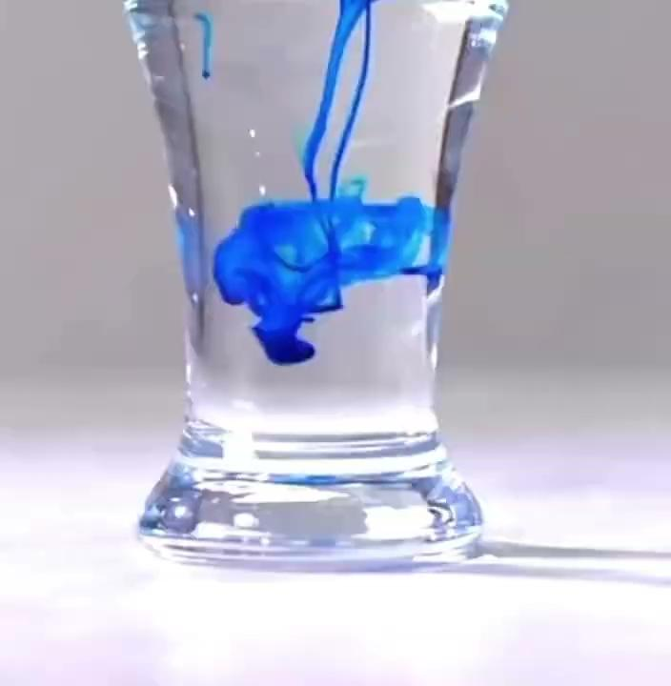

Slide 11
Rising: the air in the balloon is heated(light). The gravity is less than the buoyant force, the balloon can be lifted into the air.
Falling: the heating stops, cold air enters the balloon again, the gravity of the balloon increases and becomes heavier than the buoyant force.
Hot air balloon flight is based on the principle that hot air is less dense than cold air and the same volume of hot air is lighter than cold air, creating buoyancy.

Slide 12
Thanks for coming!

