Slide 1
Welcome to the Physics Phun Club!!

Slide 2
Chemical Reactions in physics…
Some interesting phenomena?

Slide 3
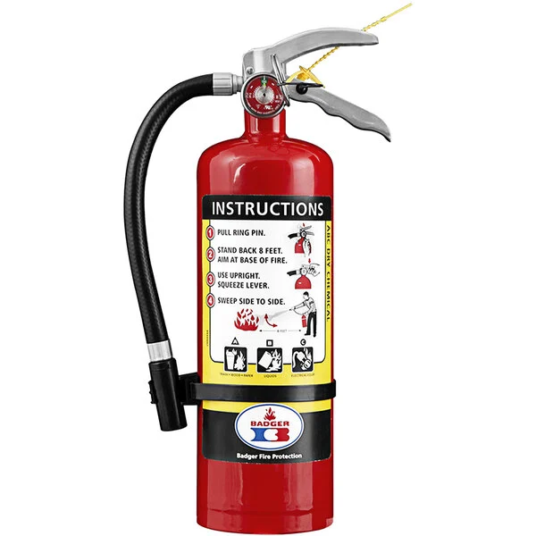
How does this thing works?

Slide 4
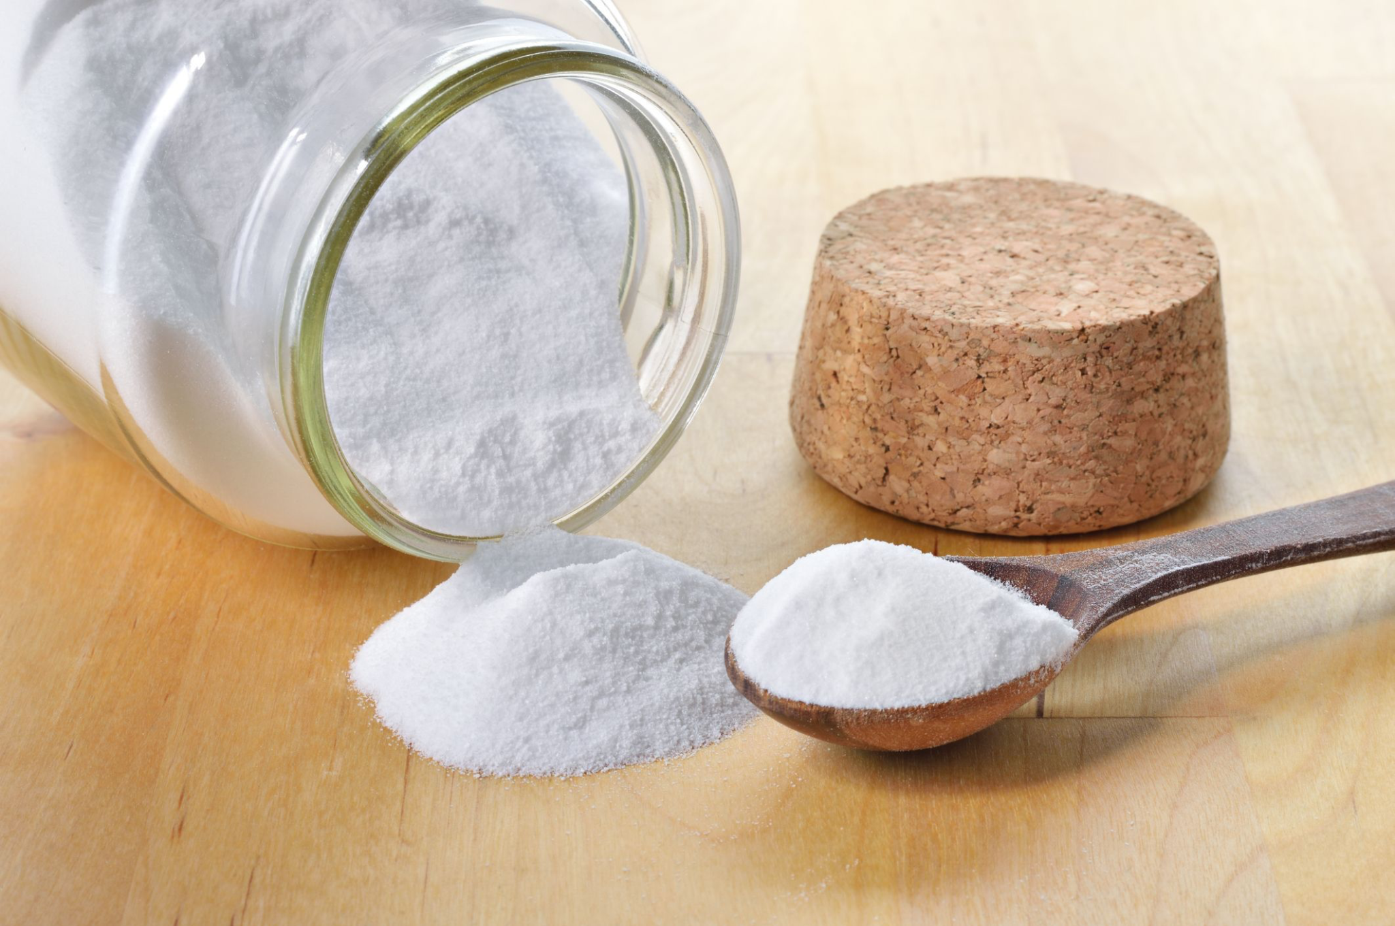
Baking Soda

Slide 5
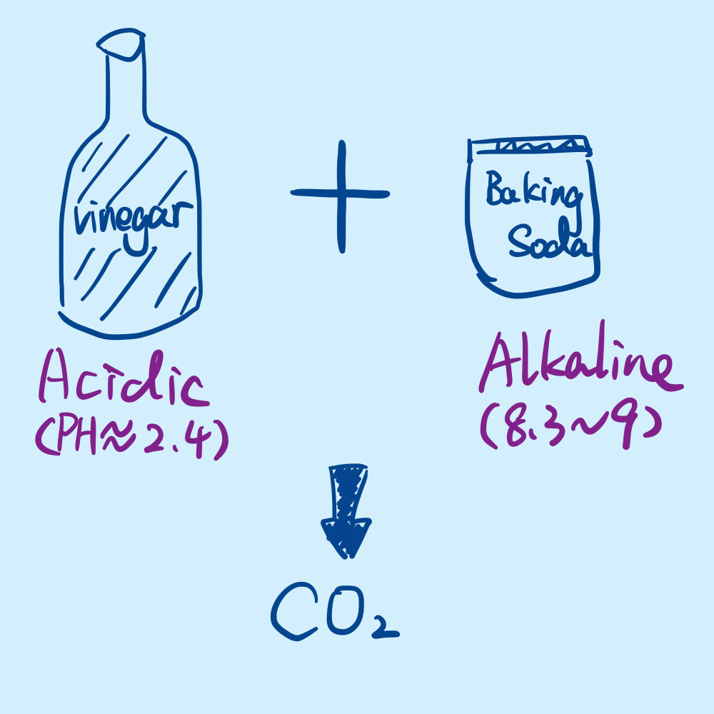

Slide 7
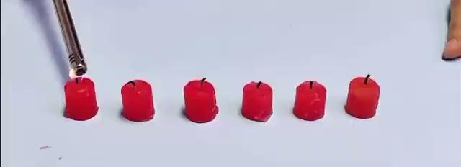

Slide 8
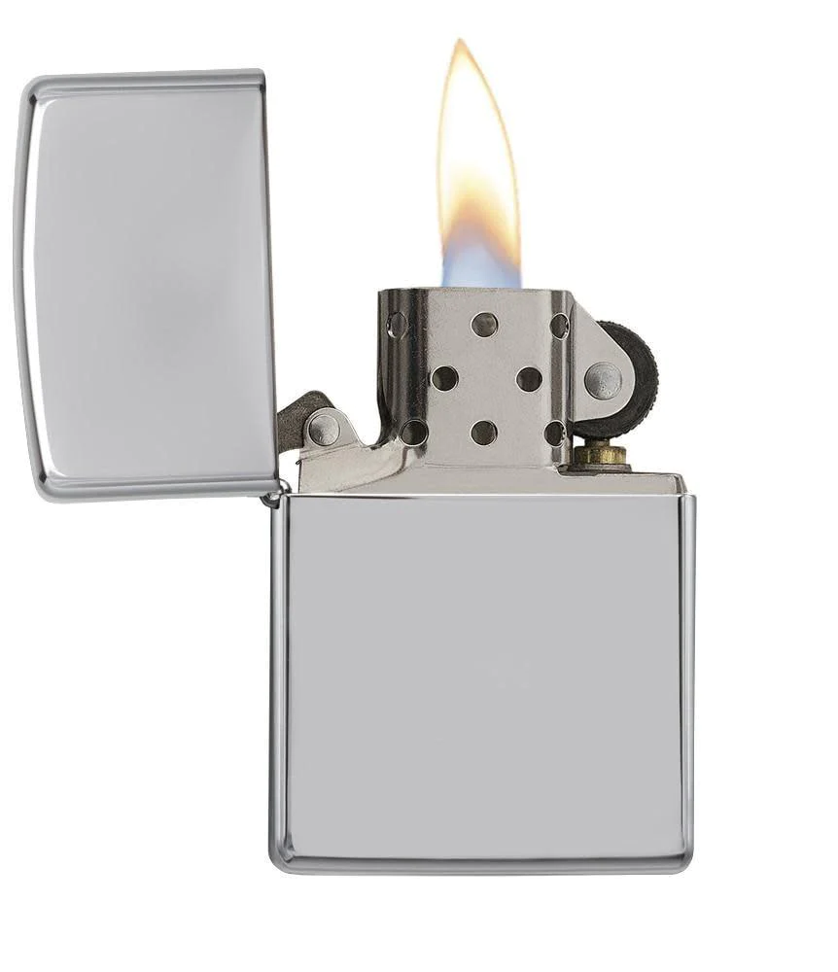
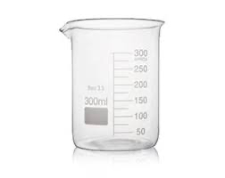

Slide 9
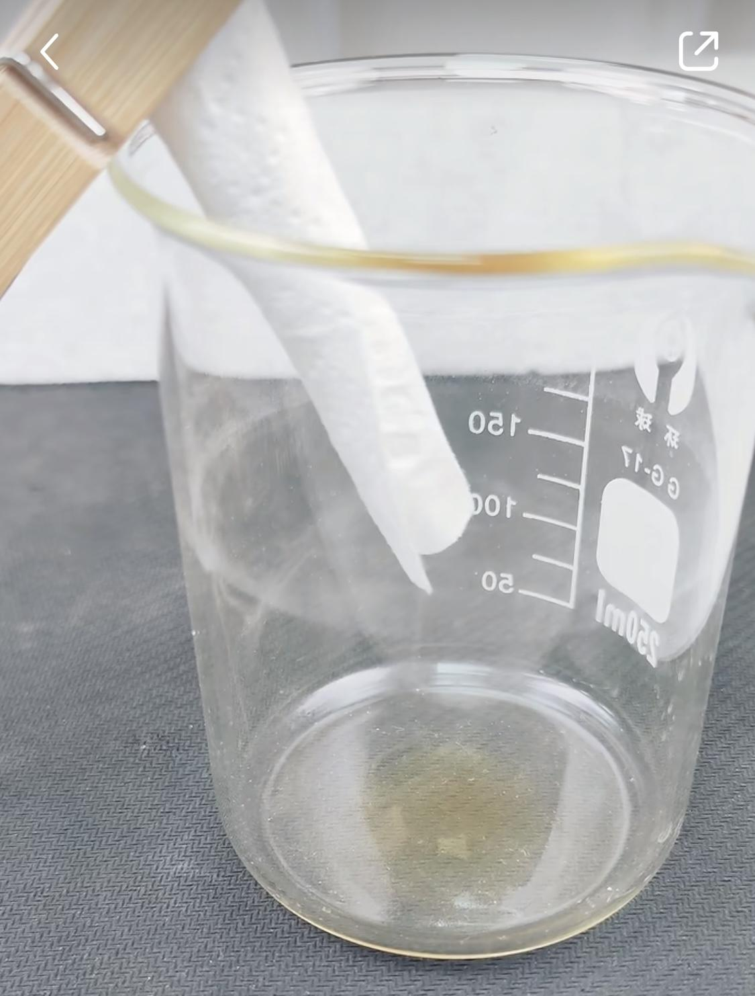
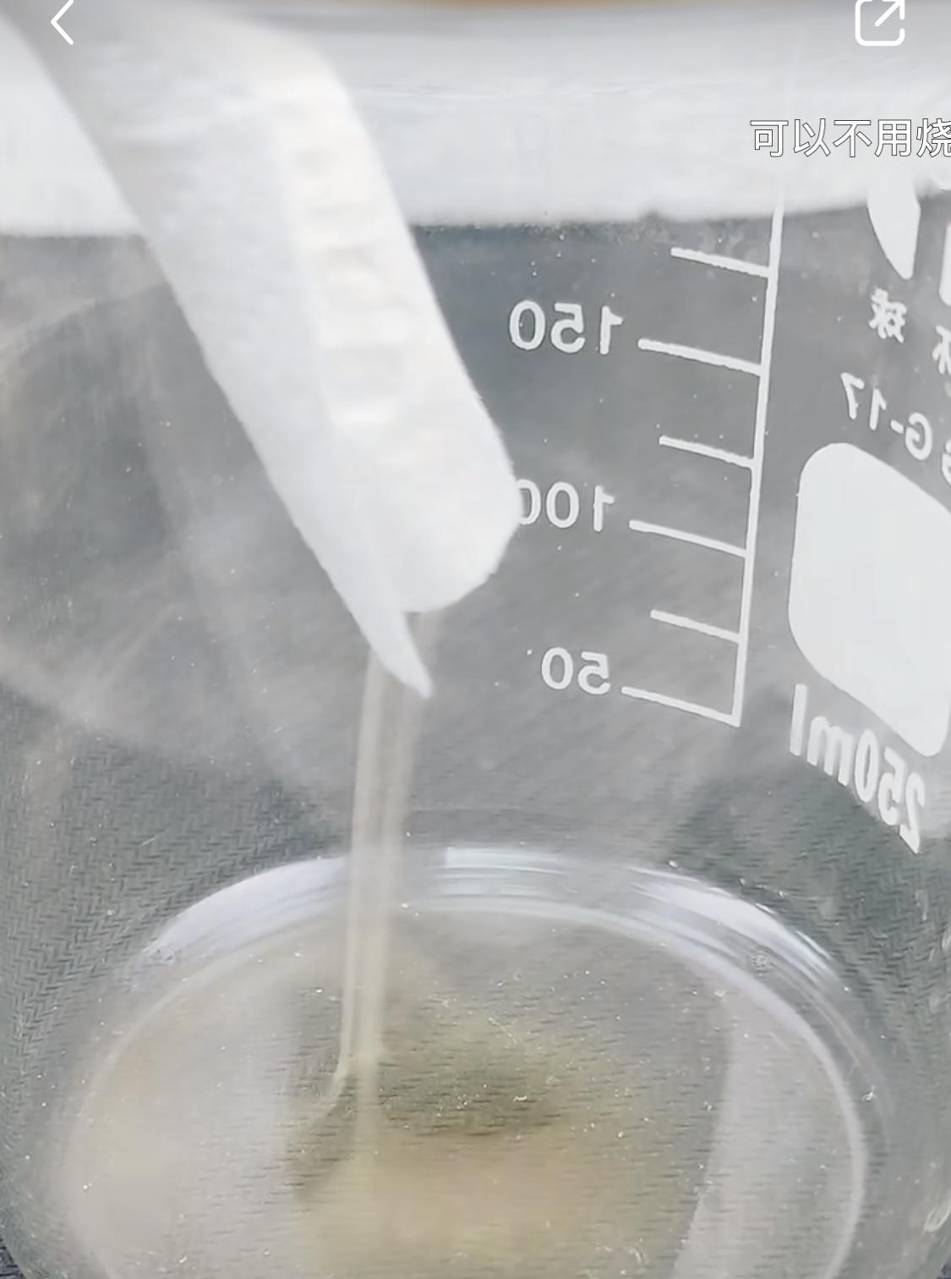
The movement of the smoke is driven by the air. Normally. The rising hot air would bring the smoke upward.
******
The space inside the paper tube is relatively small and there is not enough hot air to bring everything up. The density of incompletely burned smoke particles is greater than that of air, so the incompletely burned smoke will float downward.

Slide 10
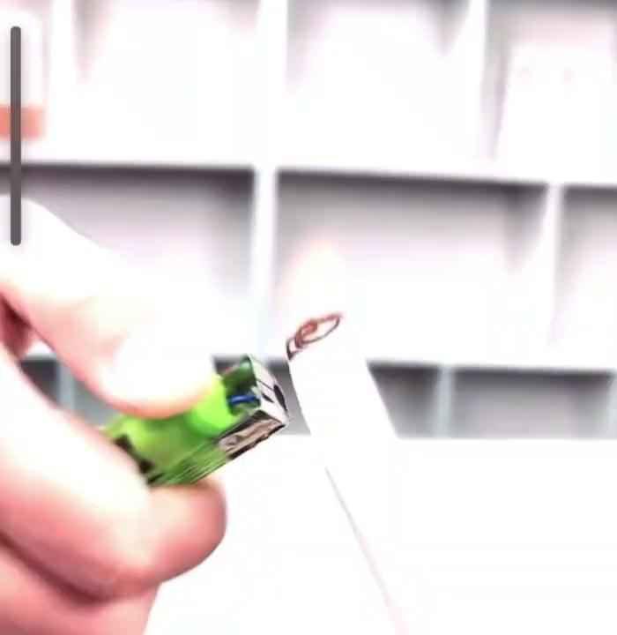

Slide 11
https://www.youtube.com/watch?v=ZPtcSXk2efU

Slide 12
Thanks!

