Slide 1
Hubble Tension
Team Awesome
Lilly, Maggie, Dora, Mary, Jenny, Rebecca, Andy, Charlie

Slide 2
Table of contents
The Expansion of the Universe
Details of the Discrepancy
01
02
Different H₀ Calculations
Current Research Teams
03
04
The expanding universe and Hubble Constant
Details of the Discrepancy
How different scientists got different H₀ values
How scientists are working to solve Hubble Tension

Slide 3
01
The Expansion of the Universe

Slide 4
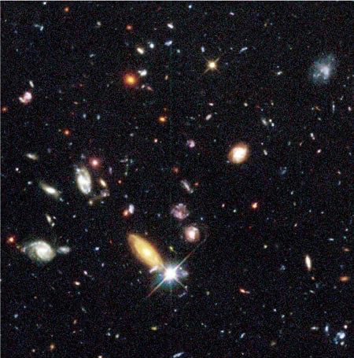
Early universe & modern universe
After the Big Bang, the universe was like a hot soup of particles. When the universe started cooling, the protons and neutrons began combining into ionized atoms of hydrogen, and eventually some helium. These ionized atoms of hydrogen and helium attracted electrons, turning them into neutral atoms - which allowed light to travel freely for the first time, since this light was no longer scattering off free electrons. The universe was no longer opaque! However, it would still be some time before the first sources of light would start to form, ending the cosmic dark ages. Exactly what the universe's first light (stars that fused the existing hydrogen atoms into more helium) looked like, and exactly when these first stars formed is not known.
Notes:
Kilometers per second per megaparsec

Slide 5
Expanding Universe
In 1929 Edwin Hubble observed the redshift of distant galaxies and deduced that the farther away a galaxy is from earth, the faster it appears to be receding
His research was the first observable evidence supporting the expansion of the universe
By knowing the rate of acceleration of the universe, scientists are able to calculate the age of the universe

Slide 6
Hubble Constant
Hubble Constant is the rate at which the universe is expanding: the ratio of an object’s recessional speed to its distance from Earth
Calculated to be 67.4 km/s/mpc in 2018 using data from the Planck Space Telescope’s map of the cosmic microwave background
calculations using Baryon Acoustic Oscillations yield the same number
Notes:
Kilometers per second per megaparsec

Slide 7
2
Details of the discrepancy

Slide 8
History of H₀
Before Hubble, Leavitt already discovered cepheids as standard candles
It was created in 1929, and was initially suggested to be 500 km/sMpc by Hubble himself
As time progresses, the value ranged from 50 to 100 km/sMpc
Freedman uses the Hubble telescope to set down the value of 72 km/sMpc
Meanwhile, Saul Perlmutter observes type Ia supernovae and determines that the universe is accelerating
Wins Nobel Prize in 2011
Leaves the quest to find the Hubble Constant even more cryptic than before
Notes:
History of H0. H0 is just another name for the Hubble constant
Before we talk about Hubble tension, we need to talk about Henrietta Levitt. She discovered cepheids: standard candles, that hubble used to create the hubble constant
The Hubble Constant was, quite obviously, created by Edwin Hubble, and was very influenced by Leavitt’s work
It was created in 1929, and at that time, Hubble estimated that it would be around 500 km/sMpc: way higher than our estimates now. In the 70s, one of Hubble’s apprentices, Allan Sandage, estimated the value to be around 50, while others suggested 100 km/sMpc.
Then, Wendy Freedman stepped in. She went to improve the cosmic distance ladder: from parallax to supernovas.
Despite the opposition from Sandage and other seniors, Freedman joins the Hubble telescope mission, launched in 1990, and leads the group that will use cepheids and supernovae as standard candles, ultimately determining the Hubble constant as a middle 72 km/sMpc with a 10% accuracy in the new century, in 2001.
Meanwhile, a group lead by Saul Perlmuhtter gather data from type 1a supernovae, and find that their data suggest that the universe is not slowing down, but is rather accelerating in its expansion. This wins them the Nobel Prize in 2011, but leaves many unanswered questions in the scientific community, evoking the questions of what is accelerating the universe and what that could mean for measuring the Hubble Constant.
Now, many teams aim to measure the Hubble constant as precisely as possible, all of them using different methods of measurement.

Slide 9
Hubble Tension
Hubble Tension is the ongoing discrepancy between the calculations for the acceleration of the expansion of the universe.
First calculated to be 67.4 km/s/Mpc in 2018
In 2019 physicists began publishing their calculations for the Hubble constant, all of which varied from the accepted value
Different values from different ages of the universe
Scientists are still debating which value to accept
Notes:
Right now, the universally accepted Hubble constant is at around 70 km/sMpc, it varies depending on who you ask.
This is because, the teams working on measuring H0 have yielded different results, causing conflict in the community. What’s more, it’s notable that measurements using early universe phenomena (like Baryon Acoustic Oscillations) have yielded way lower results than measurements using features of the current universe (like Cepheids and quasars), enhancing the idea that the universe is accelerating.
Kilometers per second per megaparsec

Slide 10
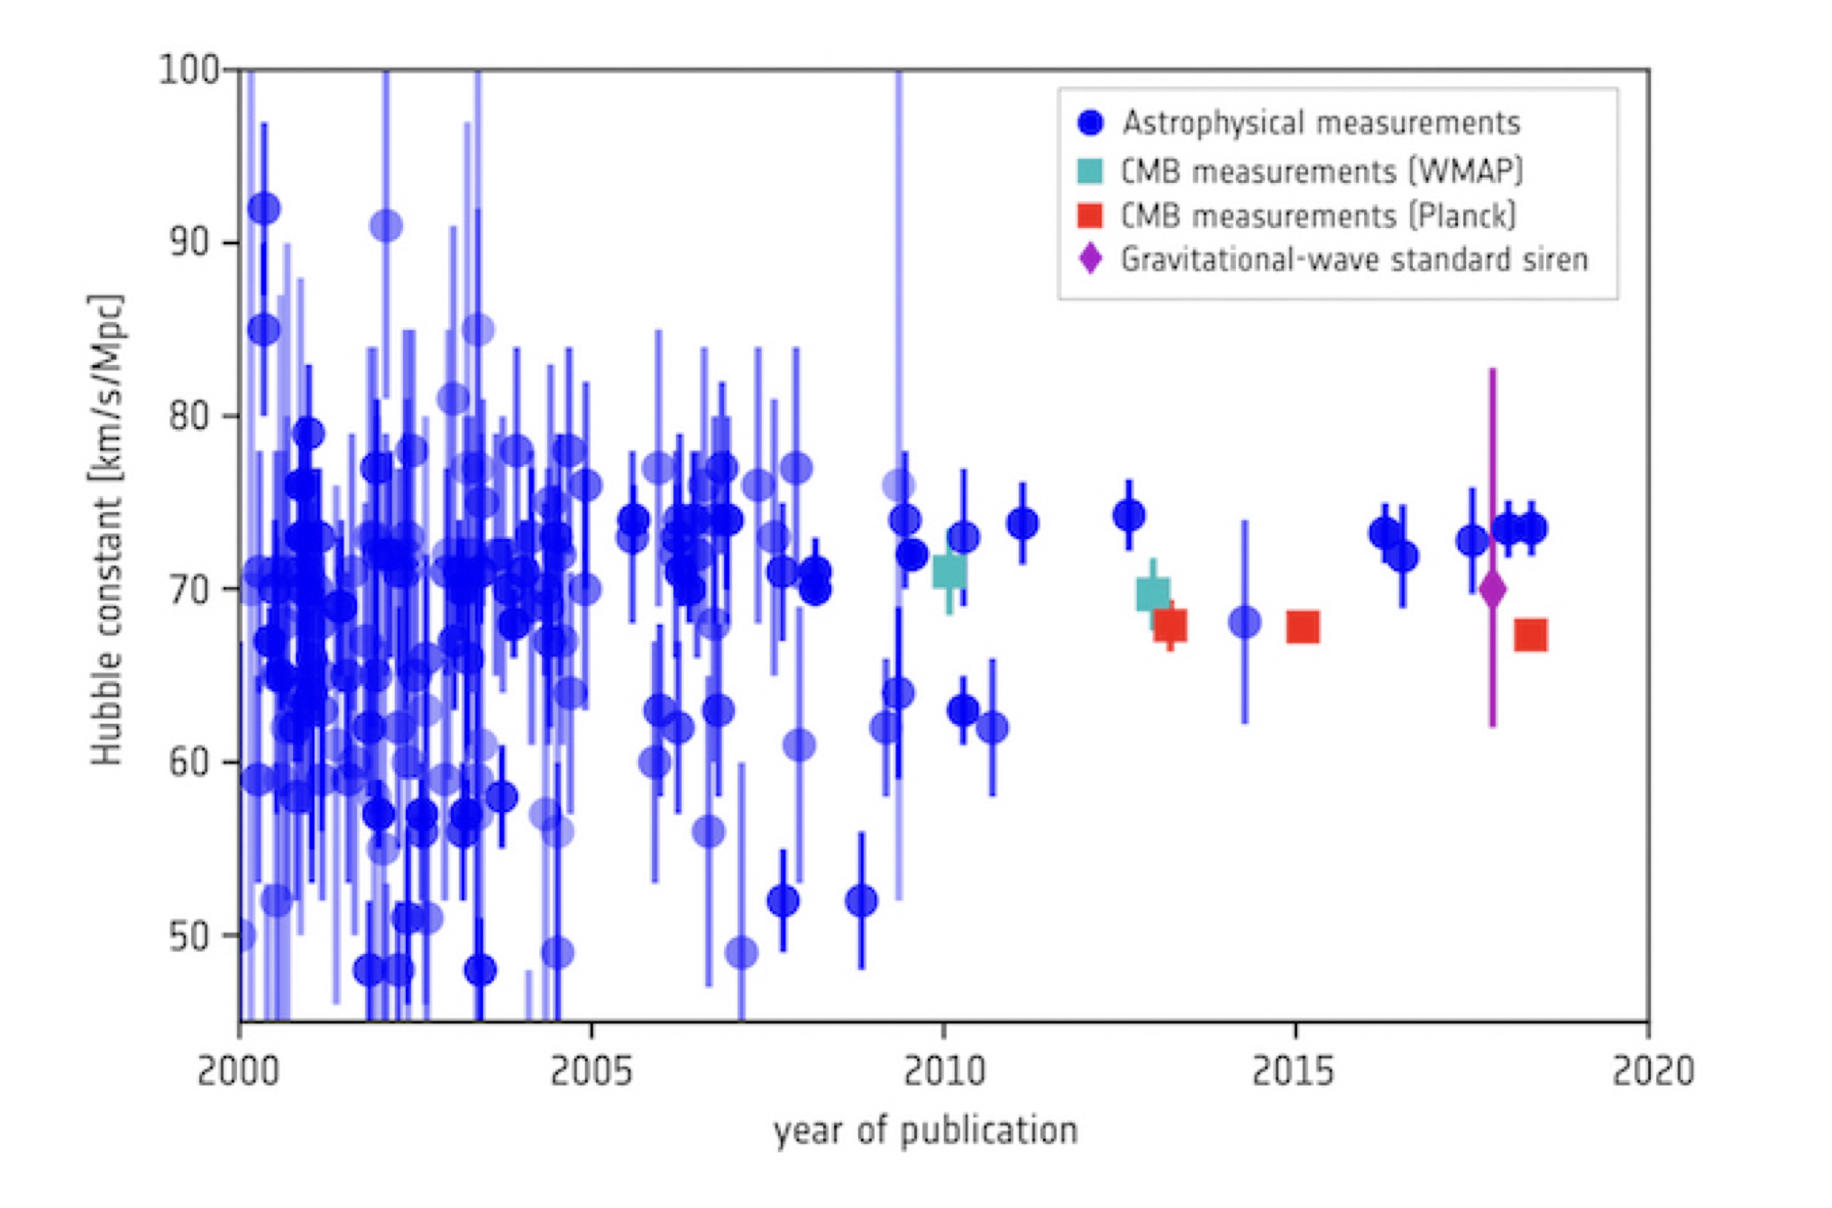
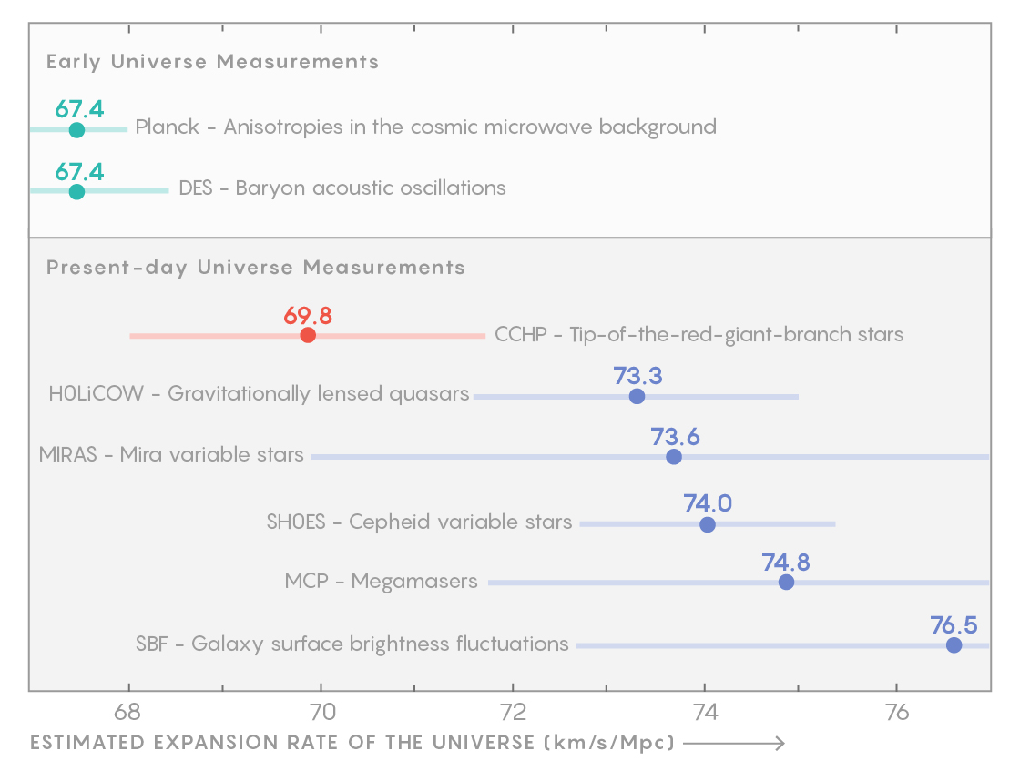
Discrepancy of measurements of hubble constant H₀
The major discrepancy has been in the local and global measurements of the Hubble constant shown in the chart.
doesn't match up to observations of the actual stars and galaxies astronomers see around us.
Either there are large systematic errors that are affecting our measurements of cosmological parameters, or we need new physics to understand our Universe and model it. (this would be mentioned later in the presentation)
Different measurements of Hubble Constant H₀
Notes:
Kilometers per second per megaparsec

Slide 11
3
Different H₀ values and how we got them

Slide 12
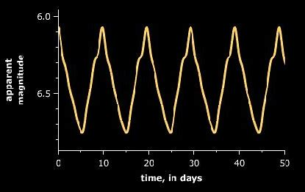
Standard Candles Used To Find H₀
TRGBs
“Tip of the red-giant branch” stars, stars like our sun that have a known peak brightness at the end of their lives
Quasars
Really bright cores of old active galaxies, the rate of change of flux for quasars is consistent
Mira Variable Stars
Low mass stars that fluctuate in brightness with a well-known period and luminosity
Cepheid Variables
Star that fluctuates in brightness with a known luminosity and period
Type 1a Supernovae
When a white dwarf absorbs its companion star, the explosion has a known luminosity
SBF (Surface Brightness Fluctuations)
Variation in galaxies’ observed brightness, further away have less variation
Notes:
TRGBs- the helium is ignited to a certain brightness as they start to die out, M = -4.0±0.1
Quasars- deep in the universe, very old black holes, M = -27, hot disk of material around black hole shows in UV, origins of the X-rays are still up for debate?, flux—the rate of energy output per unit area, periods of flux increase and decrease longer than 90 days. They found the slopes of these lines to be nearly the same, rate of change was similar for every quasar, not necessarily a good option because quasars are not well studied or known about,
Mira variable stars- M is directly related to period, longer period than cepheids (300 days), brightness changes significantly, fluctuations are changes in opacity cause by layer of hydrogen, rise and fall of brightness are more balanced in mira than cepheid
Cepheid variables- M is directly related to period, short periods (1-100 days), more luminous
Type 1a supernovae- known luminosity comes from white dwarfs being really dense and only supported by pressure of gravity, they can only get up to the Chandrasekhar limit of about 1.44 solar masses before they explode
SBF- typically older elliptical galaxies use this concept as a standard candle because they have consistent stellar populations and less dust, each small patch of a galaxy has a different amount of stars (i guess) so each patch looks a different brightness, further away galaxies have less detailed patches so they have less variation

Slide 13
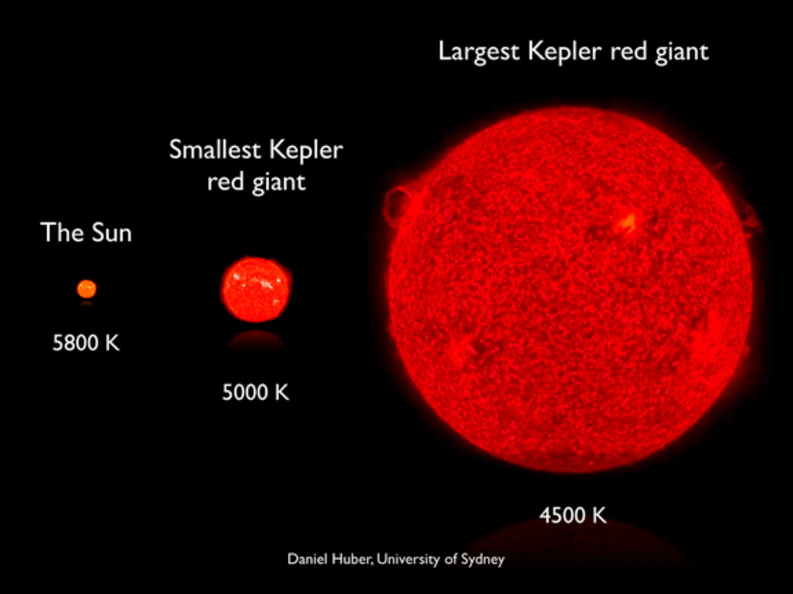
Astronomical measurement
The distance to astronomical objects
The recession velocity of each objects (the speed at which a celestial object is moving away from the observer due to the expansion of universe)
Redshift (finding how much has shifted → how fast the star is traveling away from us
V
Doppler Effect
Inverse-Square Law
F=L/(4pi*d^2)
D
Standard Candles: Cepheid Stars, Type 1a
m − M + 5 = 5log10(d)
72-73 km/s/Mpc
“Red Giants”: Stars at the end of their lives
Measuring the maximum brightness of these dying stars
Find distance to far galaxies
69.8 km/s/Mpc, Freedman

Slide 14
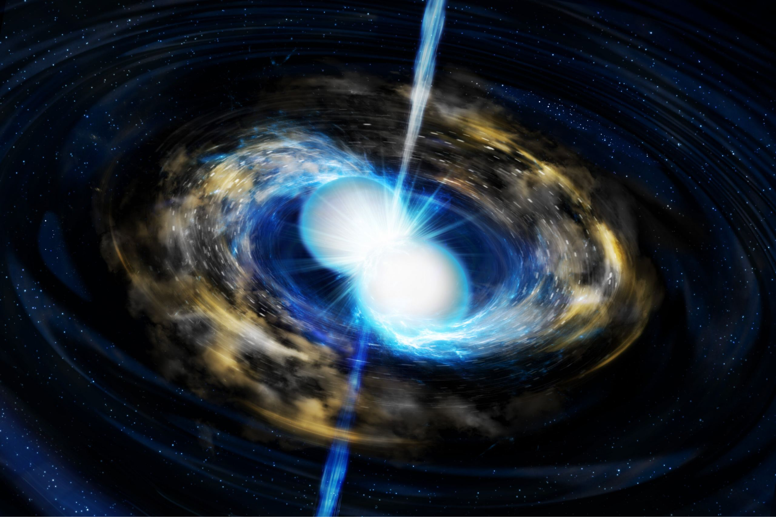
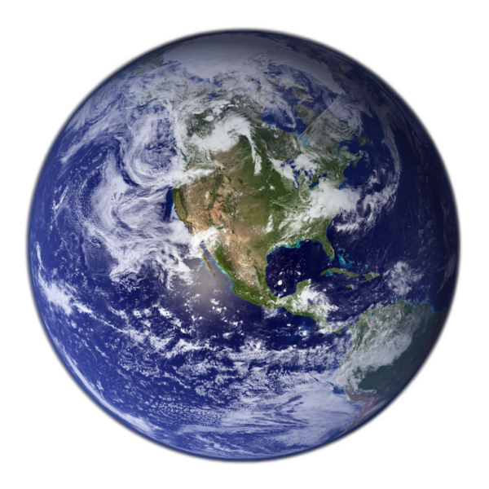
Gravitational Waves
UChicago Prof. Daniel Holz, 70 km/s/Mpc, in agreement with Freedman’s most recent work
Ripples in the fabric of space-time
Produced during highly energetic events like the neutron star collision
Can be detected using LIGO
“Standard Sirens”
How much energy the signals are carrying by the time they reach Earth
Use the shape of arriving gravitational wave signals to calculate how much energy was released when two neutron stars collide

Slide 15
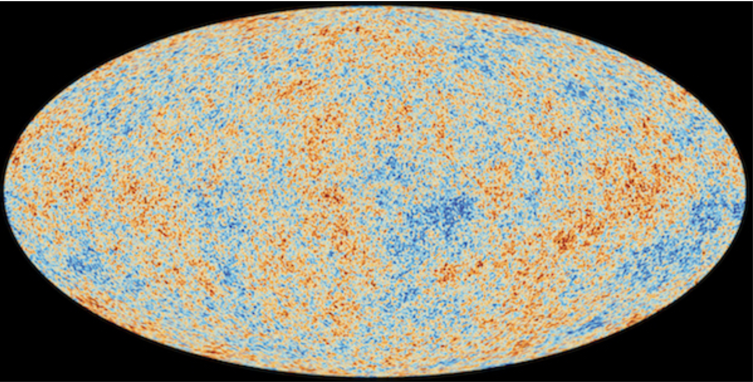
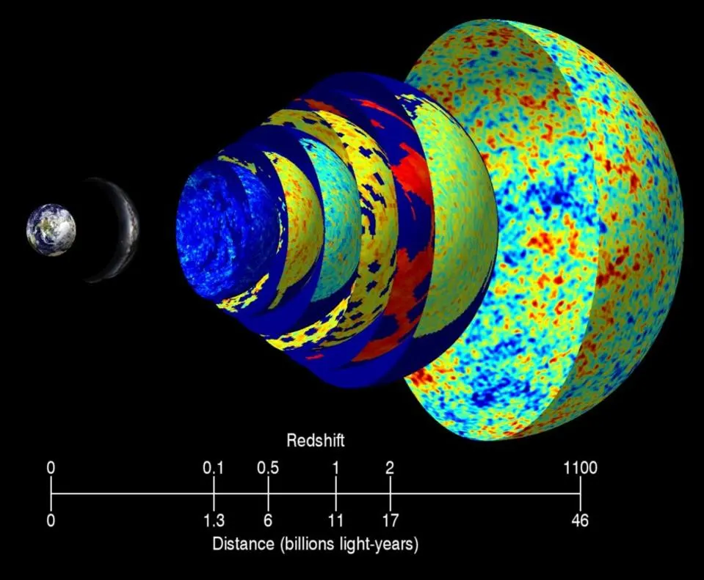
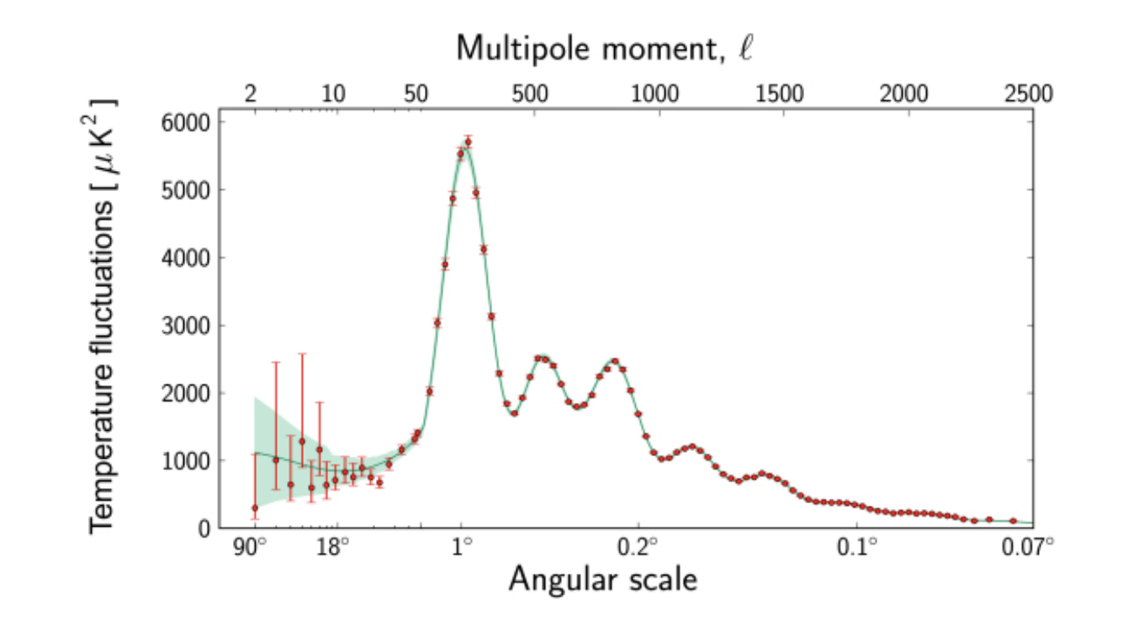
Cosmic Microwave Background Modelling
The cosmic microwave background is not uniform. The temperature fluctuations and the power spectrum give us information about the early universe, which is crucial for the modeling of the universe’s expansion. Cosmologists estimates the mass and energy contained in the universe to create model of the expansion of the universe from its initial state to present day. Using this model, scientists can predict the power spectrum which includes acoustic peaks (the result of sound waves in the early universe). By fitting the model to observed power spectrum, scientists can estimate cosmological constant like the hubble’s constant.
(73 km/s/Mpc → 67.3 km/s/Mpc, The European Space Agency’s Planck Mission)

Slide 16
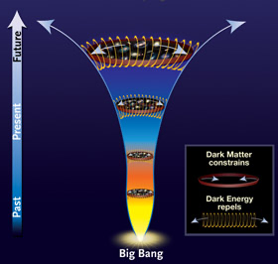
Early Dark Energy solving issue
One solution to this hubble tension conundrum could be dark energy—a mysterious, constant and as yet unobservable background energy that doesn’t spread out even when the universe is expanding. The true value of the Hubble constant could indicate that more dark energy needs to be added to the models of the very young universe to drive its early expansion. This could give scientists new information about the fundamental nature of dark energy and how it has behaved throughout the universe’s history.

Slide 17
Exploring the Causes of the Hubble Tension
Systematic Errors
New Physics
Extensive investigations have been conducted to identify potential systematic errors in both early and late universe measurements, but no clear systematic issues have been found that can fully explain the observed tension. This suggests that the Hubble tension may point to more fundamental issues in our cosmological model.
The Hubble tension has sparked renewed interest in exploring physics beyond the standard ΛCDM cosmological model, particularly in the early universe. Researchers are investigating potential modifications to the early universe that could reconcile the discrepant Hubble constant measurements and provide a more comprehensive understanding of cosmic evolution.

Slide 18
Proposed Solutions to the Hubble Tension
1
Early Dark Energy (EDE)
2
Modified Gravity Theories
One promising solution is the introduction of a new matter component, known as Early Dark Energy (EDE), in the early universe. EDE can decrease the sound horizon at recombination, allowing for a higher Hubble constant that is consistent with late-time measurements, while still satisfying various other cosmological constraints.
Alternatively, researchers are exploring modifications to the theory of General Relativity, which could alter the cosmic expansion history and potentially resolve the Hubble tension. Ensuring consistency with other observational data is crucial for these alternative gravity models.
3
Varying Fundamental Constants
4
Other Early Universe Modifications
Another proposed solution involves the possibility of changes in fundamental constants, such as the fine-structure constant, over cosmic time. These variations could impact the measurements of the Hubble constant and help reconcile the discrepancy.
Additionally, researchers are investigating other modifications to the pre-recombination physics within the standard ΛCDM model, aiming to find a solution that can bridge the gap between early and late universe Hubble constant measurements.

Slide 19
Ongoing Research and Future Prospects
1
Observational Projects
2
Theoretical Work
The James Webb Space Telescope (JWST) observations of Cepheid variables and supernovae are expected to provide valuable insights and further refinement of the Hubble constant measurements in the late universe. Simultaneously, continued efforts to improve the precision of Cosmic Microwave Background measurements will help to better constrain the early universe Hubble constant.
On the theoretical front, researchers are dedicated to refining and exploring the viability of Early Dark Energy models and other alternative early universe scenarios. This ongoing theoretical work aims to develop a more comprehensive and consistent cosmological framework that can reconcile the Hubble tension while also accounting for other observational data.
3
Independent Probes
In addition to the traditional probes, researchers are also investigating alternative, model-independent approaches to measure the Hubble constant, such as cosmic chronometers and gravitational wave standard sirens. These independent measurements can provide valuable cross-checks and further insights into the underlying cosmic expansion history.

Slide 20
4
Current research teams

Slide 21
Wendy Freedman’s Carnegie-Chicago Hubble Program (CCHP)
Wendy Freedman,
Kavli Institute for Cosmological Physics,
University of Chicago

Slide 22
A switch in the Standard Candle
Freedman’s team was originally using cepheids as their standard candle, but later switched to the “tip of the red giant branch” stars (TRGBs) to calibrate a new cosmic distance ladder
Compared to cepheids, red giants have a few advantages as a standard candle. Their brightness are less affected by dust or star clustering because of their locations. They have lower mass and thus lower metallicity dependence. We will be going into the specific advantages of this type of standard candle later but all in all, TRGBs can provide more accurate distances than cepheids.
CCHP team’s Hubble constant value in 2019: 69.8 km/s*MPc (“stuck in the middle”)
Notes:
Dust can dim stars, making them to look farther away than they really are. Meanwhile, clustering of stars can make them look brighter and therefore closer than they really are.

Slide 23
Questions upon the trgbs
Freedman’s team used Large Magellanic Cloud as their calibrators because the cloud’s distance is pinpointed very precisely using different methods.
Other scientists (Adam Riess; he will show up later again), however, points out that the Large Magellanic Cloud is very dusty itself.
Freedman responded by claiming that their team has employed a more precise method of measurement - changes in brightness as a function of color. This way we do not need to measure apparent brightness, which can be affected by dust, but instead deduce it by observing the star’s color, thereby determining its distance.
Freedman believes that more accurate measurements are needed in order to reduce systematic errors in order to confirm that there indeed dispute on the Hubble constant value.
Notes:
Dust can dim stars, making them to look farther away than they really are. Meanwhile, clustering of stars can make them look brighter and therefore closer than they really are.

Slide 24
Wendy freedman’s current study
Currently, Freedman is participating in the JWST program, which measures the Cepheids, tip of the red giant branch stars and a third star known as a JAGB star (which are aging carbon stars with a near-constant brightness) in the same galaxy, all at one distance. They will then compare the Hubble constant values derived from each of the three methods.
The JWST has four times the resolution of the Hubble Telescope at the infrared wavelength, so this helps to resolve the issue of star clustering together in a galaxy.
“As I said, I'm just completely open. I don't know where this is going to fall. But it is a question. It's an empirical question.”
Notes:
Dust can dim stars, making them to look farther away than they really are. Meanwhile, clustering of stars can make them look brighter and therefore closer than they really are.

Slide 25
Wendy freedman
3 standard candles (11 Sep 2023)
New JWST program to observe Cepheids, TRGB and JAGB stars
Uses blind analysis
Reanalyzed hubble information
The 3 stars showed consistent data
=> The scientists got a Hubble constant of about 69.1 km/sec/Mpc, which is consistent with the CMB measurements.
Wendy Freedman presented her study on the 6th of April at a meeting of the American Physical Society (picture not accurate)

Slide 26
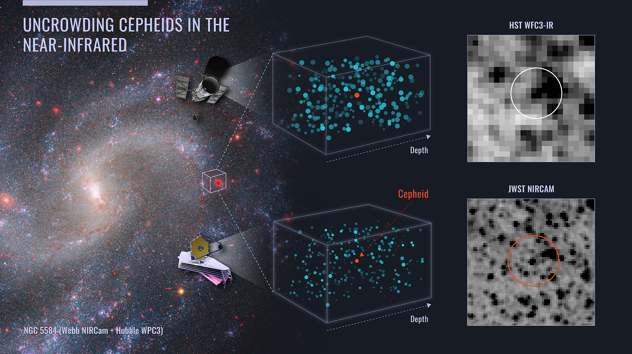
Sh0es - adam riess
JWST and Hubble collaboration (28 Jul 2023)
Webb slices through the dust and naturally isolates the Cepheids from neighbouring stars because its vision is sharper than Hubble’s at infrared wavelengths.
New observation:
5 host galaxies of 8 type 1a supernovas
1000 cepheids
Reach out to NGC 5468 (130 million ly)

Slide 28
Questions?

Slide 29
Sources
-https://news.uchicago.edu/explainer/hubble-constant-explained
-https://www.quantamagazine.org/cosmologists-debate-how-fast-the-universe-is-expanding-20190808/
https://www.livescience.com/space/it-could-be-profound-how-astronomer-wendy-freedman-is-trying-to-fix-the-universe
-https://webbtelescope.org/contents/early-highlights/webb-confirms-accuracy-of-universes-expansion-rate-measured-by-hubble
-
https://www.phys.ufl.edu/courses/phz6607/fall20/Reports/Shubhagata_Bhaumik_Hubble_Discrepancies.pdf
-https://www.livescience.com/space/it-could-be-profound-how-astronomer-wendy-freedman-is-tryingto-fix-the-universe
https://hubblesite.org/mission-and-telescope/hubble-30th-anniversary/hubbles-exciting-universe/measuring-the-universes-expansion-rate
https://knowablemagazine.org/content/article/physical-world/2023/early-dark-energy-resolving-cosmic-acceleration-mismatch#:~:text=So%20early%20dark%20energy%20is,light%20that%20suffuses%20the%20cosmos.

