Slide 1
Quantum Mechanics
₍^. ̫.^₎
Team Awesome
Dora, Lilly, Mary, Maggie, Jenny, Rebecca, Andy, Charlie

Slide 2
Table of contents
01
02
03
Introduction to
Quantum Mechanics
Math of
Quantum Physics
Applications

Slide 3
01
Intro to quantum mechanics
ᓚ₍ ^. .^₎

Slide 4
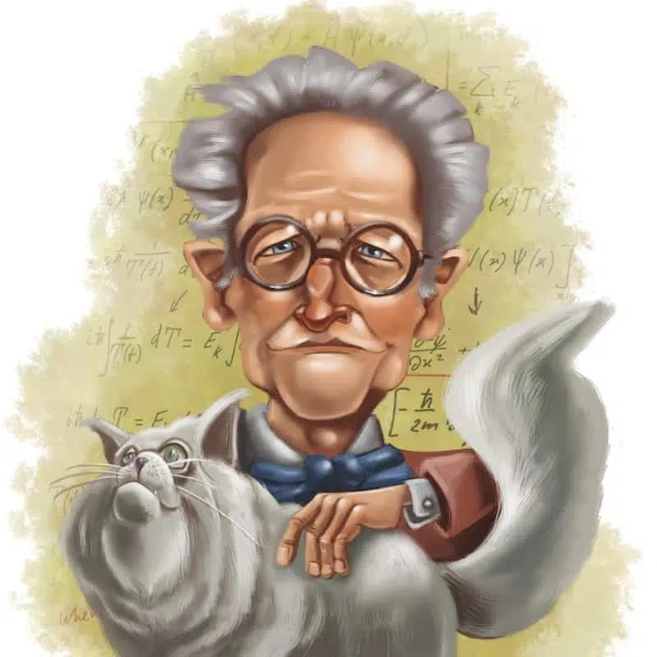
What is Quantum Mechanics?
The study of very small things
When classical physics start breaking down

Slide 5
Quantum Eraser Experiment
A variation of Double Slit Experiment
Proposed by Scully and Drühl in 1982
Realized first in early 1990s
Demonstrates Quantum mechanics
Shows the counter-intuitiveness of quantum nature
Entangled Photon pair created
One photon goes through a double-slit
The other is measured for the information of the first photon (which path)
Depending on the measurement, the interference pattern is preserved or erased.
ฅ^._.^ฅ

Slide 6
Delayed-Choice Quantum Eraser
≽^•༚• ྀི≼
Signal photon is detected before the detection of idler photon. When idler photons provide which path information there are no interference pattern shown; if the path is erased there are interference pattern shown.
Shows the counter-intuitiveness of quantum mechanics
Challenges our classical notions of causality and the nature of reality before measurement
The choice of either preserve of erase which path information is after the detection of interference pattern, seemingly changing the past

Slide 7
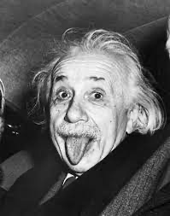
Brief History of Quantum Mechanics 1
╱|、
(˚ˎ 。7
|、˜〵
じしˍ,)ノ
1900: Max Planck proposed E = hν = ̄hω,
( h ≈ 6.63 · 10−34 J · s, ̄h ≡ h/2π = 1.06 · 10−34 J · s)
got rid of the problem of the blackbody radiation problem
correctly predicted the shape of the power curve as a function of temperature
adds the information of how many lumps of energy a wave contains.
1905: Albert Einstein
Photoelectric effect
relates the momentum of a photon to the wavenumber of the wave it is associated with.
1913: Bohr claims electrons in atoms have wavelike properties
1924: Louis de Broglie proposed that all particles are associated with waves; frequency and wavenumbers of the wave are given by the same relations we found for photons.

Slide 8
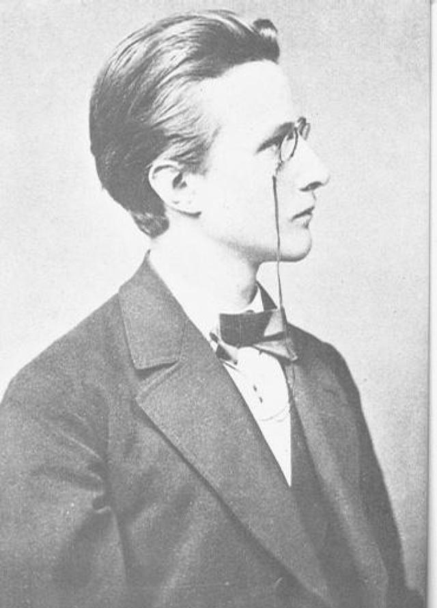
Brief History of Quantum Mechanics 2
ㅤ/ᐠ - ˕ -マ
1925: Werner Heisenberg formulated a version of quantum mechanics that made use of matrix mechanics.
1926: Erwin Schrodinger formulated a version of quantum mechanics that was based on waves.
1926: Max Born correctly interpreted Schrodinger’s wave as a probability amplitude.
1926: Paul Dirac showed that Heisenberg’s and Schrodinger’s versions of quantum mechanics were equivalent, in that they could both be derived from a more general version of quantum mechanics.

Slide 9
2
Math of
Quantum physics
ᯓᡣ𐭩
/ᐠ - ˕ -マ ノ
乀( J し)

Slide 10
Wave Nature of Matter
∧,,,∧
( ̳• · • ̳)
/ づ♡
Louis de Broglie in 1924: “All matter behave like waves do!!”
Electrons, baseballs, and supernovas all have wavelengths governed by this equation:
𝛌 = h/p = h/mv
That being said, most objects’ matter wave (aka de Broglie wave) are so small that we can practically neglect them.
Ex. For a baseball with mass 0.145kg traveling at 10m/s, its de Broglie wavelength is:
𝛌 = h/mv
= (6.63 * 10^-34) / (0.145) (10)
= 4.42 * 10^-34 m
For the sake of comparison, the diameter of an electron is 100000000000000000000 longer than this baseball’s wavelength.

Slide 11
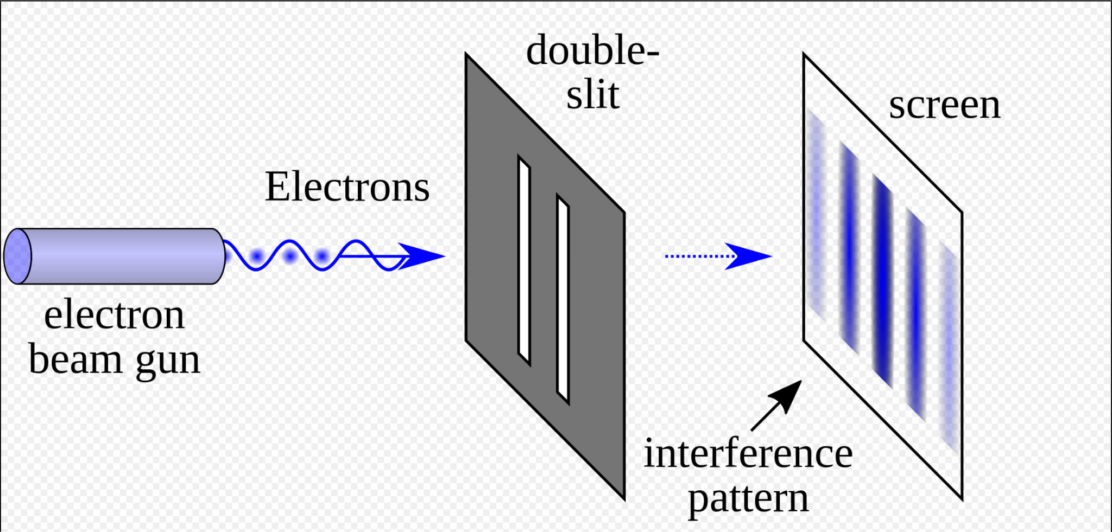
Wave Nature of Electron
>ܫ<
But at the scale of an electron, (diameter of an electron is around 10^-18 m) the wave properties of matter begin to be significant.
In 1927, Davisson and Germer set up a double-slit experiment for electrons. They observed the exact same interference pattern of electrons as Thomas Young’s experiment on light back in 1801, which proved how light behaves like waves.

Slide 12
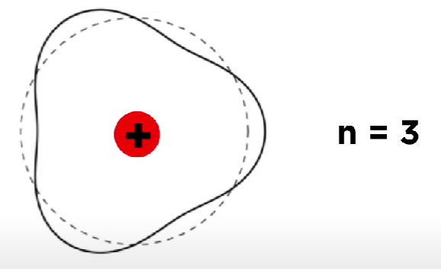
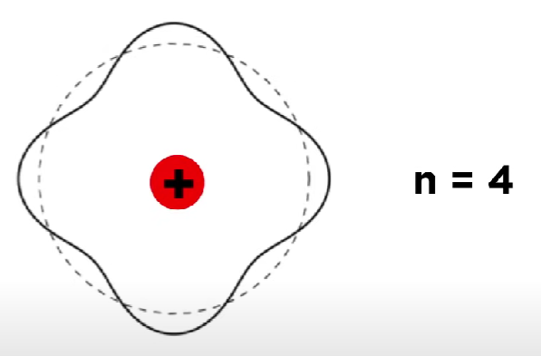
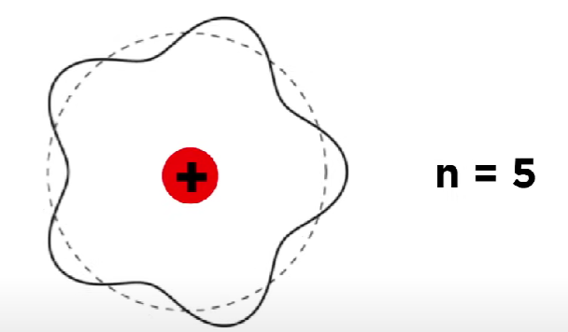
Electrons as Standing Waves
^•ﻌ•^ฅ♡
But what exactly does it mean to that electrons behave like waves?
We can think of electrons as a circular standing waves (as opposed to linear standing waves we learned in classical physics):
An electron must have an integer number of wavelengths to form a closed-loop. The n here is also the energy level that we see in Bohr’s model of hydrogen. This shows why electrons can only inhabit discrete energy levels.

Slide 13
The Way of the Waves
•⩊•
After understanding how electrons can possess wave properties, scientists have set out to find a mathematical equation to model this probability waves that govern the motion of all subatomic particles…… This equation will turn out to be one of the most fundamental equations in the entire field of quantum mechanics.

Slide 14
Energy of light
ฅ(ᵔ꒳ ᵔマ.ᐟ
Notes:
So first, here are some basic equations for light, energy and how they relate
1.Max Planck suggests that light is quantized (of later discovered photons)
h is the planck constant, hbar is the reduced planck’s constant
h = 6.63 · 10^−34 Js
h bar = h/2pi = 1.06 · 10^−34 Js
v = frequency
w = angular frequency(rad/sec). 2pi/period
k = wavenumber(rad/m). 2pi/wavenumber
2. Einstein’s theory of relativity
3. Angular frequency for light
4. and 5. Combining the equations and cancelling out
1.The energy of light is just its kinetic energy and potential energy. We are working with one dimension first, because it helps us set down the basics of the equation and find out how space relates with time (as seen with Einstein’s theory of relativity too, where we set both delta y and z to 0)
2. Here, we leave potential energy as V(x), as it is only a function of x
3. Use p=mv to replace mv^2. Divide the equation by p^2
4. p=hk, replace p with hk

Slide 15
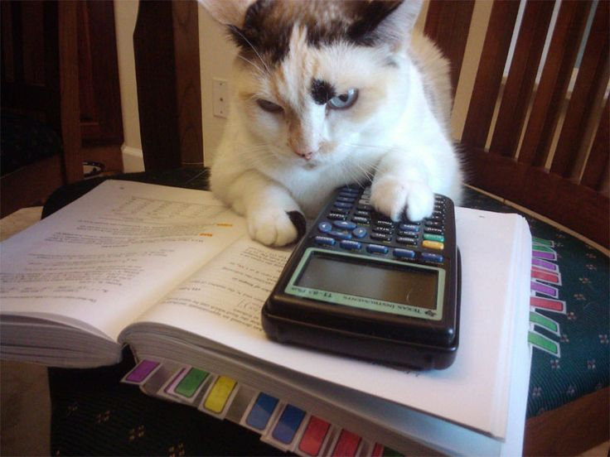
Schrödinger’s equation
Ansatz:
Notes:
1. Phi is a wave function that we want to find
You want to find a function of phi so its partial derivatives can replace k and w, which we don't want in the final equation
An exponential function is used simply for simplicity, as sine and cosine are harder to use
2. The first partial derivative with respect to t
3. The second partial derivative with respect to x
4. Replacing k and w in the energy of light equation, we get this equation

Slide 16
Schrödinger’s equation
/\_/\
= • . • =
/ \
Notes:
Here is the final equation of schrodinger’s equation with the wave function phi of x and t placed in
This is the time-dependent schrodinger’s equation. There is a time-independent equation too, but we won’t talk about that here
There are a few “problems” with this equation, not as in inconsistencies, but rather its limitations.
First, we’re using 1D here, but if you want to add the y and z axis, ∂ ^2ψ/∂^x2 term becomes the sum of all the spatial axes. This is much more complicated
Secondly, the equation, though very useful, isn’t proven yet, and most probably won’t be proven in a long time, or ever, since, although data can support it very well, it can never say for certain that this formula will always be applicable.
You might be asking, how does this equation work if there’s the complex number i in it? Well, this wave function is a complete guess, as sine and cosine are more complex than the exponential. And the i doesn’t really matter because anything you could to measure, so position, momentum, energy, etc will always be a real quantity, and that’s really what matters

Slide 17
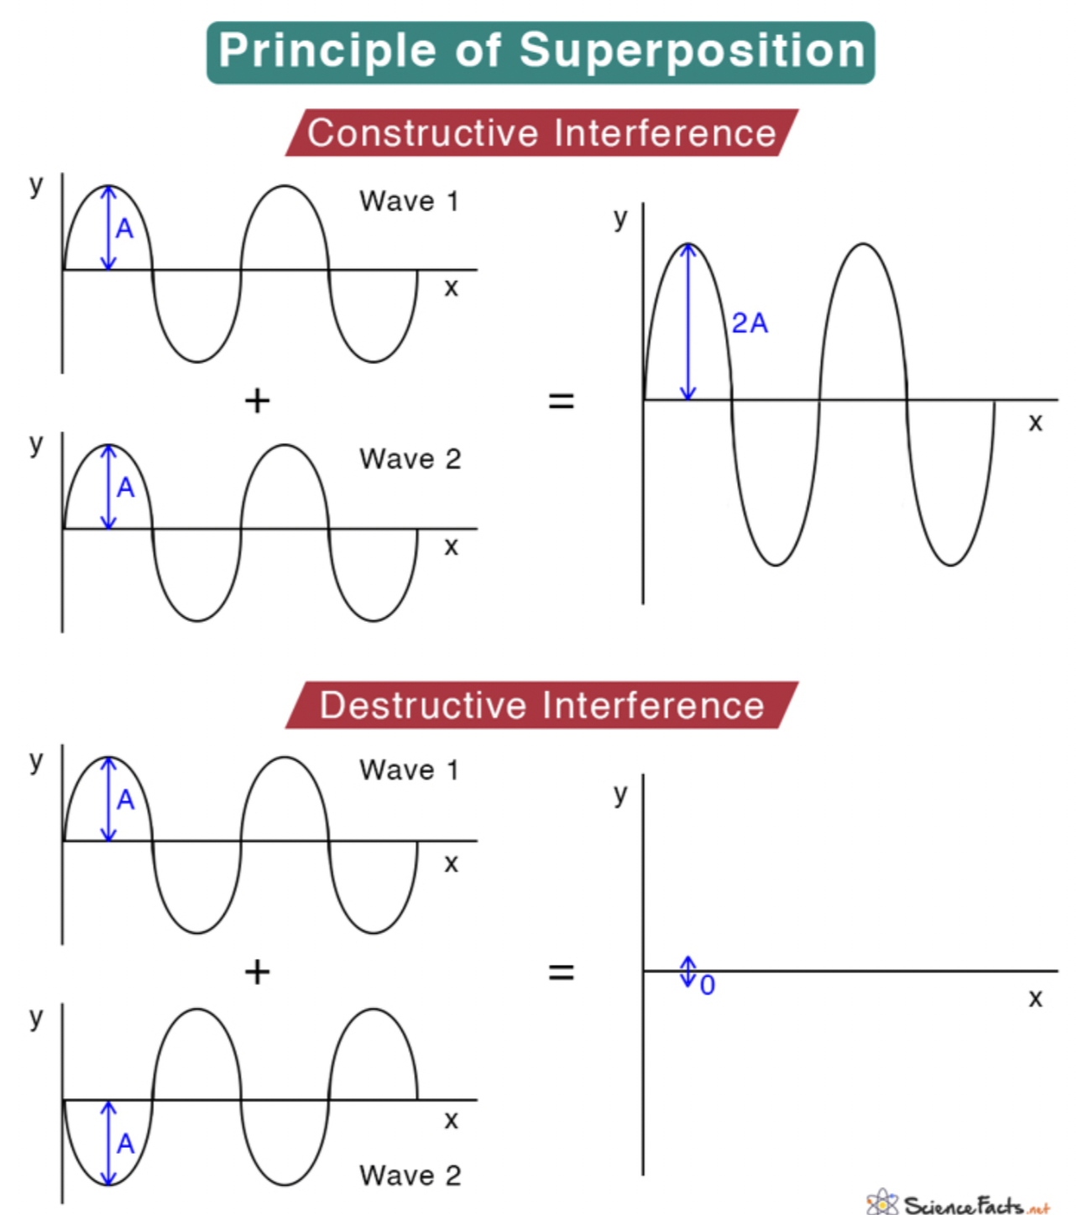
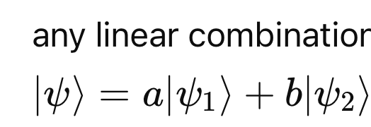
Superposition principle
Superposition is the ability of a quantum system to be in multiple states at the same time until it is measured.
a particle can be in a state that is the superposition of states with various definite energies
Any general wavefunction is built up from a superposition of the states in the equation with different values of E, just as the general motion of a string is built of from various normal modes with different frequencies ω.
it’s easy for classical waves to be in a superposition of normal modes with different energies, by Fourier analysis

Slide 18
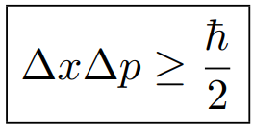
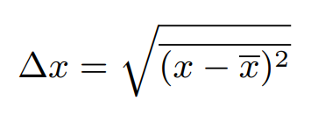
Heisenberg’s Uncertainty Principle
Heisenberg’s Uncertainty Principle is a mathematical inequality that puts a numerical limit to the accuracy of an object’s position and momentum:
We can rearrange the equation to calculate the probability range (not the change!) of Δx and Δp (the range under which the object’s position or momentum could be)
Here, Δx and Δp indicates the standard deviation of position and momentum.
This, for example, is how we calculate the standard deviation for position
𐚁 へ ╱|𐚁
૮ - ՛ ) (` - 7
/ ⁻ ៸| |、⁻〵
乀 (ˍ, ل ل じしˍ,)ノ

Slide 19
Heisenberg’s Uncertainty Principle
>^..^<
Notice that the right side of the inequality is VERY small:
ħ= 1.054571817×10^-34 J*s, so ħ/2 is roughly 5.275*10^-35 J*s…
Substitute this value back, we have:
Δx ⋅ Δp ≥ 5.275*10^-35
Or,
Δx ⋅ mΔv ≥ 5.275*10^-35
If m is large, say 1 kg for your basketball, or 1000 kg for your car, then your Δx and Δv need not to be large - in fact, they are tiny - to satisfy this inequality. This means that although all objects cannot bypass the uncertainty principle, we can still be confidently sure about the position and velocity of our basketball or car at the same time (or else NBA or Le Mans will probably be impossible to happen). But it does matter when it comes to subatomic level. (For reference Mass of electron = 9.1093837 × 10-31 kilograms)

Slide 20
Heisenberg’s Uncertainty Principle
>^•-•^<
If you want to measure something, you will need to look at it: you shine photons to the object and observe the ones that bounce off in your direction.
Since photons carry momentum, they will transfer some of that momentum to the particle when they hit it. The problem is, we don’t know how much of the photons’ momentum are being transferred, because the value is completely random.
Furthermore, we know that if we want to locate the position more accurately (smaller Δx) , we need to reduce the wavelength of the light shone on it (this is why UV microscopes has a higher resolution than visible light microscopes).
Since the momentum of a photon is:
p = E/c = hν/c
Where ν = c/λ
So, p = h/λ
So the shorter the wavelength, the greater the momentum. This then increases Δp, hence decreasing Δx. This confirms that a smaller Δx indeed requires a large Δp.

Slide 21
03
Applications
𝑍 𝑧 𝑧
／￣￣ヽ￣￣＼♡︎
∠ レ | ⌒ ヽ♡︎
＼＿＿ノ丶 )
(_と＿_ノ⊂ニノ
how quantum mechanics are being used

Slide 22
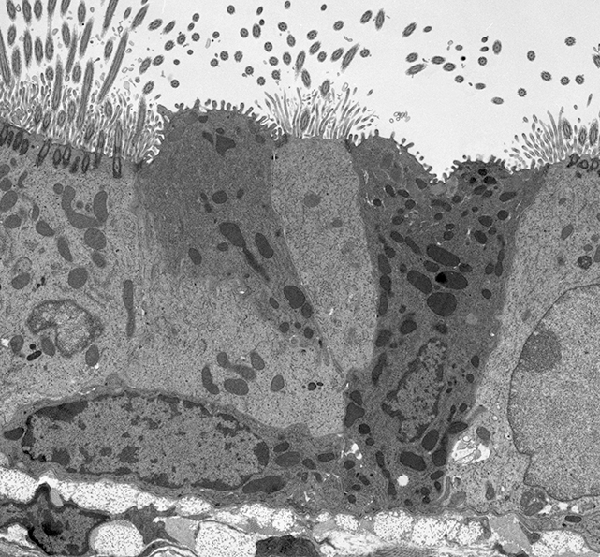
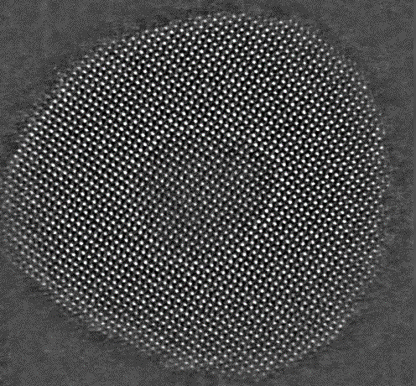
Electron Microscopes
ᓚ₍ ^. .^₎
Transmission Electron Microscope (TEM)
used to view structures inside of materials
resolution of .05nm
generates electrons, accelerates them to 70% speed of light
electron beam varies by the material and density of specimen
image of specimen is imprinted in the electron beam and then magnified 2 million times
image is ~5cm wide, large enough to be captured by camera
mouse lung
gold
Notes:
Electron Microscope
Scanning Electron Microscope (SEM)
Used for surface images (butterfly, toothbrush)
Max resolution 1 nm
Transmission Electron Microscope (TEM)
Structures inside materials
Can take images of proteins inside mitochondria, or particles of gold
More complex than SEM
Resolution of 50 picometer - roughly size of hydrogen atom
Commonly used in developing cutting edge tech
Generates electrons and accelerates them to around the speed of light, creating a beam of electrons
Magnetic lenses focuses the electrons down to a small area and shoots/transmits electrons through the specimen
Electrons are scattered as the pass through the specimen, varying by different densities and materials
Imprints an image of the specimen onto the beam of electrons
Beam is then magnified 40 times using an objective lens
Further magnified 50,000 times by a set of projector lenses
After this the image is about 5cm wide - large enough to be captured by a high resolution camera sensor at the bottom of the microscope
Why electrons and not light??
Visible light is physically limited to magnifications up to ~2,000x
Zooming in further leaves image blurry, doesnt reveal more details
Electrons can reach meaningful magnifications of up to 2milx
Why is visible light limited
Visible light has avg wavelength of 540nm - larger than the distance between points that the EM can see
As light hits the two points (in video example), creates a pair of propagating waves resulting from interference of two waves
Blurs image
Cant resolve images of features less than ~300nm
TEM
Electrons are accelerated to 70% the speed of light - 300,000km/s
Wavelength of 2.5 picometers (200x smaller than visible light wavelength)
Real resolution is 50picometers
Thats enough to see individual atoms
Science and engineering of TEM
Field Emission Source generates free electrons
Negatively charged electrons attracted to positively charged fields
Electrons in tungsten crystal needle are attracted to extractor ring which is connected to +5,000V
Series of metal rings 10k volts apart which accelerates the electrons
Specimen is usually 100nm thick
Vacuum pump used to create vacuum so as not to scatter the electrons among air particles
Condenser lens
Focus electrons from source to project onto sample
Uses apertures in path of beam to filter out stray electrons - ensures electrons are more parallel to each other
Objective and projector lenses
Magnify the image being imprinted into the electron beam up to width o a few cm
Objective lens - Magnifies image 40x
Projector lens magnifies image 50k times
Magnetic lenses act as convex/converging lenses, which focuses all electrons down to focal point
As electrons pass focal point and expand they magnify the image, which depends on strength of magnetic field, position of lenses, position of dtectors and cameras
Phosphorescent screen
Glows when electrons hit it
Camera is used to view screen
System used to align microscope
When ready to capture image, screen moves out of way and image is captured w more sensitive camera CMOS camera
Screen is used to ensure system is set up correctly bc electron beam could damage cmos camera
SEM
Create a focused spot and scan across object
Electrons bounce off and create secondary electrons
Back scattered electrons
X rays
Measure these for details about the surface topology and chemical composition
Resolution is limited by how small we can make the focused spot and how deep the electrons penetrate into the sample
Practical resolution around 1nm
STEM combines both

Slide 23
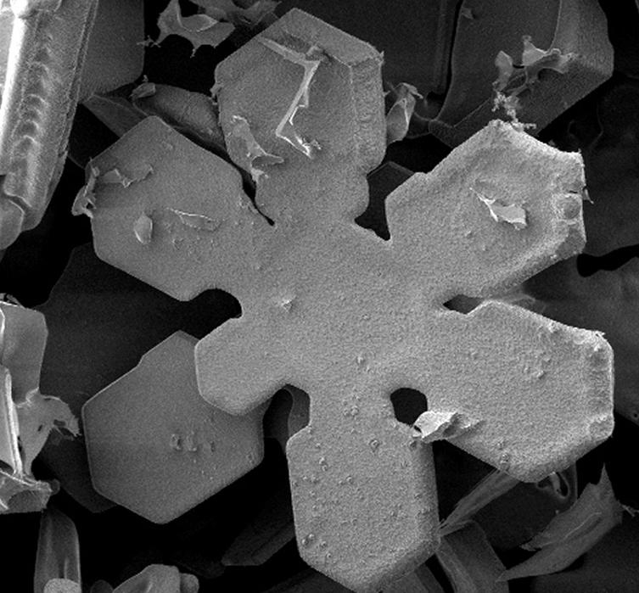
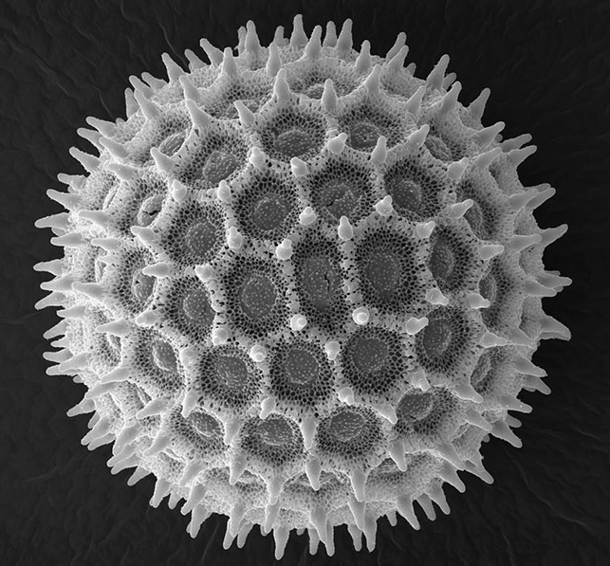
Electron Microscopes
∧,,,∧
( ̳• · • ̳)
/ づ♡
Scanning Electron Microscope (SEM)
used to scan the surface of specimens
resolution of 1nm
creates a focused beam of electrons and scans across the surface of an object
electrons bounce off specimen and create secondary electrons
secondary electrons can be measured for details about the surface and the chemical makeup
snowflake
pollen
ant
Notes:
Electron Microscope
Scanning Electron Microscope (SEM)
Used for surface images (butterfly, toothbrush)
Max resolution 1 nm
Transmission Electron Microscope (TEM)
Structures inside materials
Can take images of proteins inside mitochondria, or particles of gold
More complex than SEM
Resolution of 50 picometer - roughly size of hydrogen atom
Commonly used in developing cutting edge tech
Generates electrons and accelerates them to around the speed of light, creating a beam of electrons
Magnetic lenses focuses the electrons down to a small area and shoots/transmits electrons through the specimen
Electrons are scattered as the pass through the specimen, varying by different densities and materials
Imprints an image of the specimen onto the beam of electrons
Beam is then magnified 40 times using an objective lens
Further magnified 50,000 times by a set of projector lenses
After this the image is about 5cm wide - large enough to be captured by a high resolution camera sensor at the bottom of the microscope
Why electrons and not light??
Visible light is physically limited to magnifications up to ~2,000x
Zooming in further leaves image blurry, doesnt reveal more details
Electrons can reach meaningful magnifications of up to 2milx
Why is visible light limited
Visible light has avg wavelength of 540nm - larger than the distance between points that the EM can see
As light hits the two points (in video example), creates a pair of propagating waves resulting from interference of two waves
Blurs image
Cant resolve images of features less than ~300nm
TEM
Electrons are accelerated to 70% the speed of light - 300,000km/s
Wavelength of 2.5 picometers (200x smaller than visible light wavelength)
Real resolution is 50picometers
Thats enough to see individual atoms
Science and engineering of TEM
Field Emission Source generates free electrons
Negatively charged electrons attracted to positively charged fields
Electrons in tungsten crystal needle are attracted to extractor ring which is connected to +5,000V
Series of metal rings 10k volts apart which accelerates the electrons
Specimen is usually 100nm thick
Vacuum pump used to create vacuum so as not to scatter the electrons among air particles
Condenser lens
Focus electrons from source to project onto sample
Uses apertures in path of beam to filter out stray electrons - ensures electrons are more parallel to each other
Objective and projector lenses
Magnify the image being imprinted into the electron beam up to width o a few cm
Objective lens - Magnifies image 40x
Projector lens magnifies image 50k times
Magnetic lenses act as convex/converging lenses, which focuses all electrons down to focal point
As electrons pass focal point and expand they magnify the image, which depends on strength of magnetic field, position of lenses, position of dtectors and cameras
Phosphorescent screen
Glows when electrons hit it
Camera is used to view screen
System used to align microscope
When ready to capture image, screen moves out of way and image is captured w more sensitive camera CMOS camera
Screen is used to ensure system is set up correctly bc electron beam could damage cmos camera
SEM
Create a focused spot and scan across object
Electrons bounce off and create secondary electrons
Back scattered electrons
X rays
Measure these for details about the surface topology and chemical composition
Resolution is limited by how small we can make the focused spot and how deep the electrons penetrate into the sample
Practical resolution around 1nm
STEM combines both

Slide 24
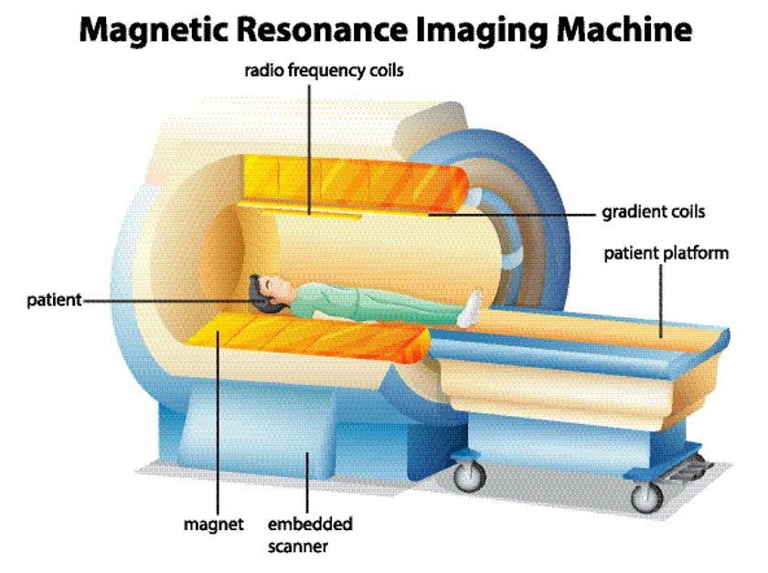
MRI scanners
/\__/\
=(,,>ヮ<,,)= <◟𝘺𝘦𝘺 ! )
/ ◠ ◠ \ノ
Notes:
Solar Cells
“incoming light, exhibiting wave-like properties, is concentrated by mirrors and lenses, passing through the silicon wafer. Once inside the cell, it collides with electrons – displaying particle-like properties – knocking the electrons loose and freeing them to create an electric current between the panel and batteries or the grid.” -https://www.azoquantum.com/Article.aspx?ArticleID=180
Simple explanation:
Crystalline Silicon wafer (160-240 micrometers)
Difference created by doping the silicon – “by diffusing an n-type dopant into one side of a p-type wafer (or vice versa).”
N-type material has an excess of electrons: “Adding atoms with a greater number of valence electrons than silicon to a silicon lattice results in the creation of free electrons.” in this case, adding phosphorous to n-type
Adding boron (slightly more protons, called holes) to create p-type
Doping each side separately leaves a p-n junction in the center
Sunlight hits the solar cell (antireflective)
Wafer absorbs 350-1140nm wavelengths of light (visible light)
Photons from sunlight excite the electrons in the p-n junction layer, causing them to move around and leave a proton “hole”
Electron moves to n-type layer, negatively charged
Protons move to p-type layer, positively charged
The charge difference between layers creates an electric field
Adding a wire creates current
Electrons in n-layer are free to move through the wire down to p-layer and pair with protons
Flow of electrons is current

Slide 25
Laser
₍^>ヮ<^₎
Light
Amplification by
Stimulated
Emission of
Radiation
Flash Bulb
Ruby
100% reflected
Monochromatic: same color (Lambda)
Coherent: same phase
Collimated: thin Beam
98% reflected

Slide 26
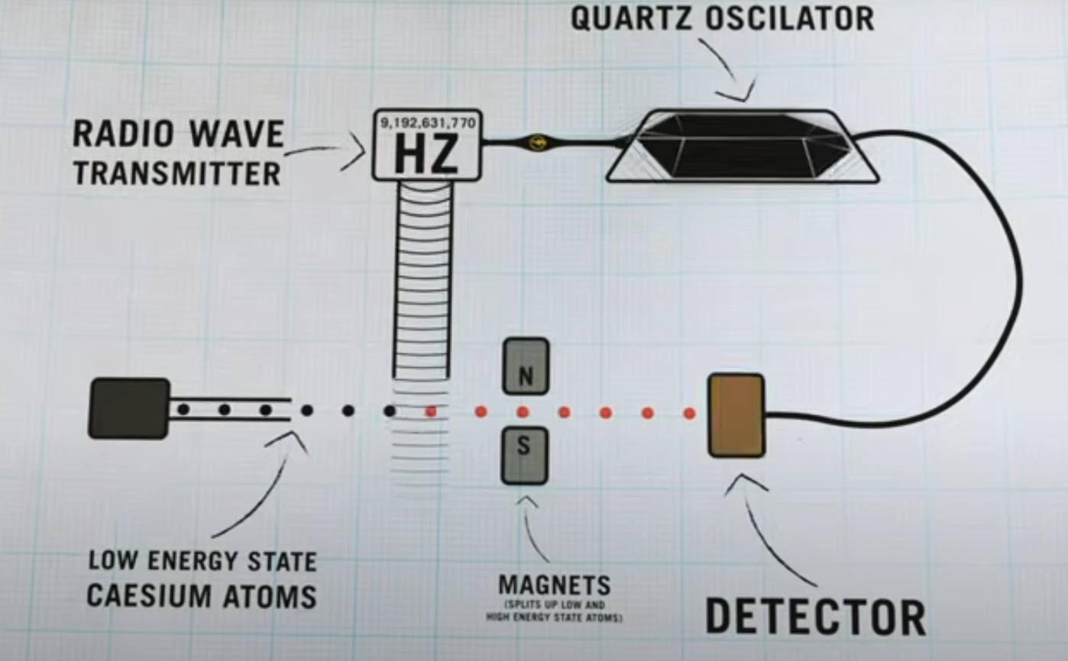
Atomic Clocks
/\___/\
꒰ ˶• ༝ - ˶꒱
./づ~🍨
cesium atoms are commonly used
quartz oscillator sends electrical pulses to determine the frequency with a radio transmitter
when hit with radio waves tuned to its exact frequency, the cesium atom will change to a higher energy state
the number of radio waves determines when a second has passed
if the frequency isn’t quite right, fewer cesium atoms are detected, so more energy is sent to the quartz to make the cesium atoms resonate again, atomic clocks self-adjust
important for GPS
Notes:
Frequency reference: an object that oscillates at a constant rate
-other clock frequency references (pendulum, quartz) change over time due to temps and pressure
-atoms are virtually immune to environmental factors (their oscillation rates)
-atoms from the same element oscillate at exactly the same rate
-9,192,632,770 oscillations of a caesium 133 atom (its resonant frequency)
-caesium 133 atoms are commonly used because they have a very stable/predictable frequency
- radio frequency is in Hertz (waves/sec)
What other atoms can be used? Rubidium, strontium, hydrogen
GPS: satellites need to send and measure signals traveling at light speed, small variations in frequency can cause significant errors, a deviation of one-thousandth of a second could throw off a GPS route by 300 km
Everyone else has a kahoot…

Slide 27
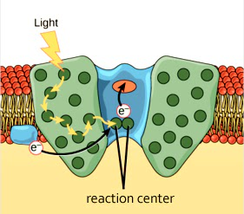
Photosynthesis
/\_/\
(˶ᵔ ᵕ ᵔ˶)
/>🌷<\~⁠♡
an electron within the chlorophyll that’s hit by a photon will become excited
arrangement of chlorophyll molecules are like a maze that leads to the reaction center, where energy is stored
reaction center is nearly impossible to reach classically, the maze could absorb the photons’ energy before it reaches the reaction center
using quantum superposition, the energy can simultaneously travel along all possible paths to the reaction center
Notes:
-light lands on leaf as photons
-chlorophyll is a green pigment that is involved in photosynthesis, found in chloroplasts of plant cells and some bacteria and algae, absorbs red and blue light and reflects green light
-chemical energy, which is used to synthesize organic compounds (like sugars) from carbon dioxide and water
-chloroplast is essential for the growth and survival of plants,
-every second in sunlight brings a leaf thousands of trillions of photons
-almost every red photon is captured and its energy processed
-photons have about one nanosecond to get to the center

Slide 28
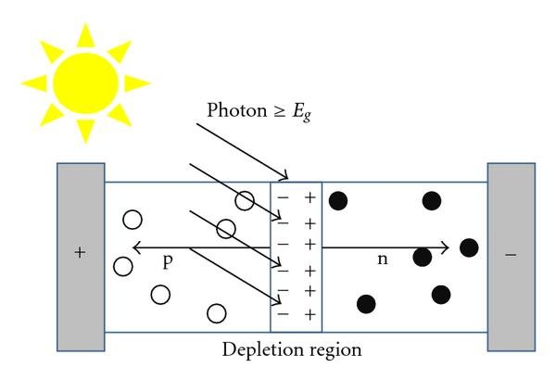
Solar Cells
a.k.a. Photovoltaic Cells
/ᐠ⎚-⎚マ
crystalline silicon and doping – p-n junction
photons from sunlight excite silicon particles – electrons and protons separate
electrons and protons move to n-type and p-type areas
charge difference creates an electric field
adding a circuit allows electrons to move to protons, creating an electric current
Notes:
Solar Cells
“incoming light, exhibiting wave-like properties, is concentrated by mirrors and lenses, passing through the silicon wafer. Once inside the cell, it collides with electrons – displaying particle-like properties – knocking the electrons loose and freeing them to create an electric current between the panel and batteries or the grid.” -https://www.azoquantum.com/Article.aspx?ArticleID=180
Simple explanation:
Crystalline Silicon wafer (160-240 micrometers)
Difference created by doping the silicon – “by diffusing an n-type dopant into one side of a p-type wafer (or vice versa).”
N-type material has an excess of electrons: “Adding atoms with a greater number of valence electrons than silicon to a silicon lattice results in the creation of free electrons.” in this case, adding phosphorous to n-type
Adding boron (slightly more protons, called holes) to create p-type
Doping each side separately leaves a p-n junction in the center
Sunlight hits the solar cell (antireflective)
Wafer absorbs 350-1140nm wavelengths of light (visible light)
Photons from sunlight excite the electrons in the p-n junction layer, causing them to move around and leave a proton “hole”
Electron moves to n-type layer, negatively charged
Protons move to p-type layer, positively charged
The charge difference between layers creates an electric field
Adding a wire creates current
Electrons in n-layer are free to move through the wire down to p-layer and pair with protons
Flow of electrons is current

Slide 29
Black Body Radiation
What is a Black Body?
/\_/\ ♡
>(• ༝ • )<
| \
| | | )_
l--l- --/ /
| |
\ \
\/

Slide 30
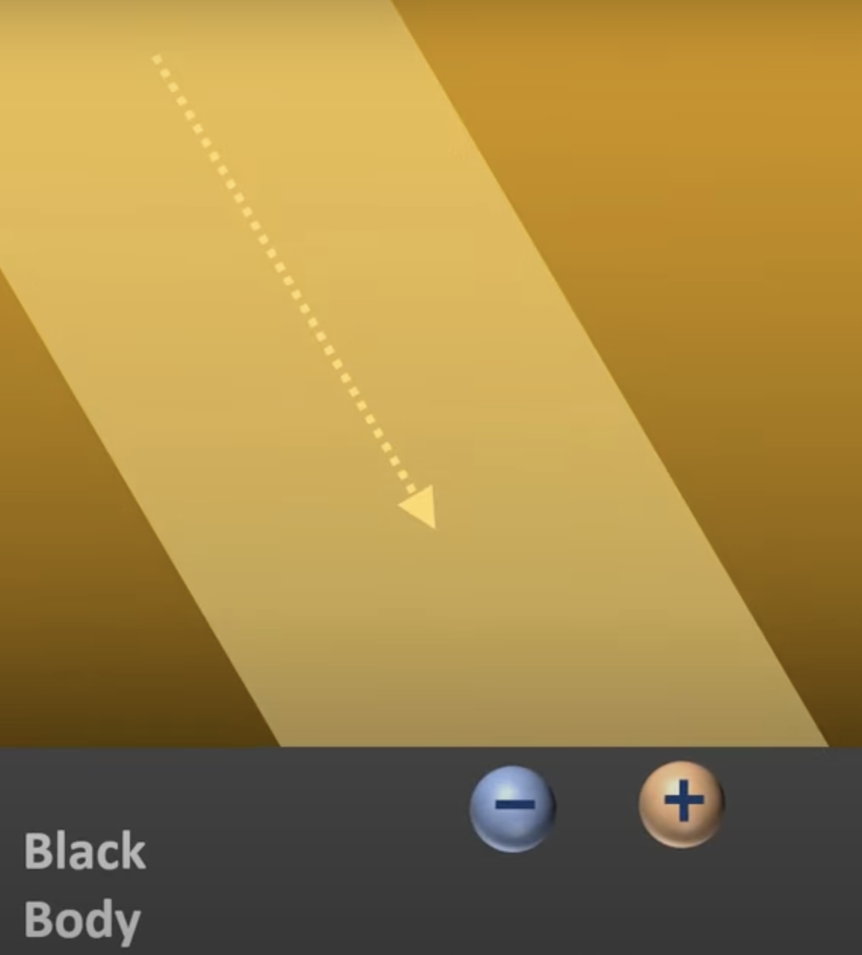
How a Black Body Radiates?
╱|
( - ˕ - 7_
૮ ૮ __乀)
Light interact with the surface of the black body
Proton and electron start to oscillate
Electrons are less massive than protons, so they hold most of the energy
When charges oscillate → generate oscillating electric field → electromagnetic wave = light

Slide 31
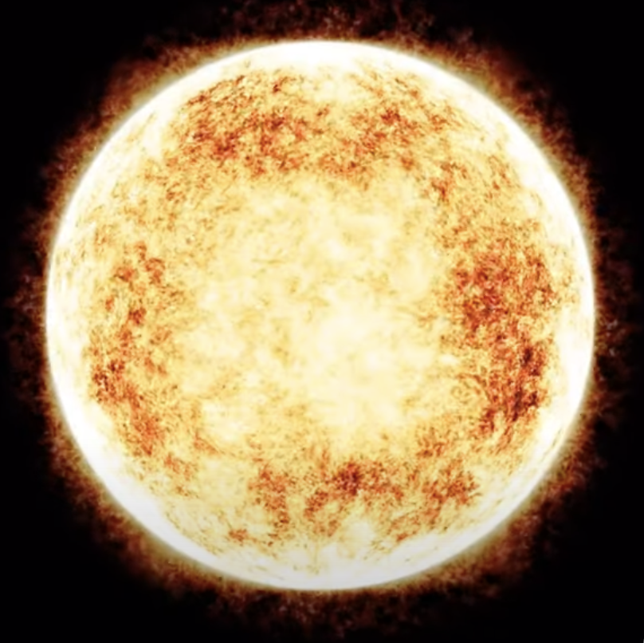
It can also be heated by other processes…
Heated by nuclear fusion
Electrons gain KE → accelerate → electric field changes → Electromagnetic waves→ star emits lights
/\___/\
_____ (=0 - 0=)_____​​​
​ U U

Slide 32
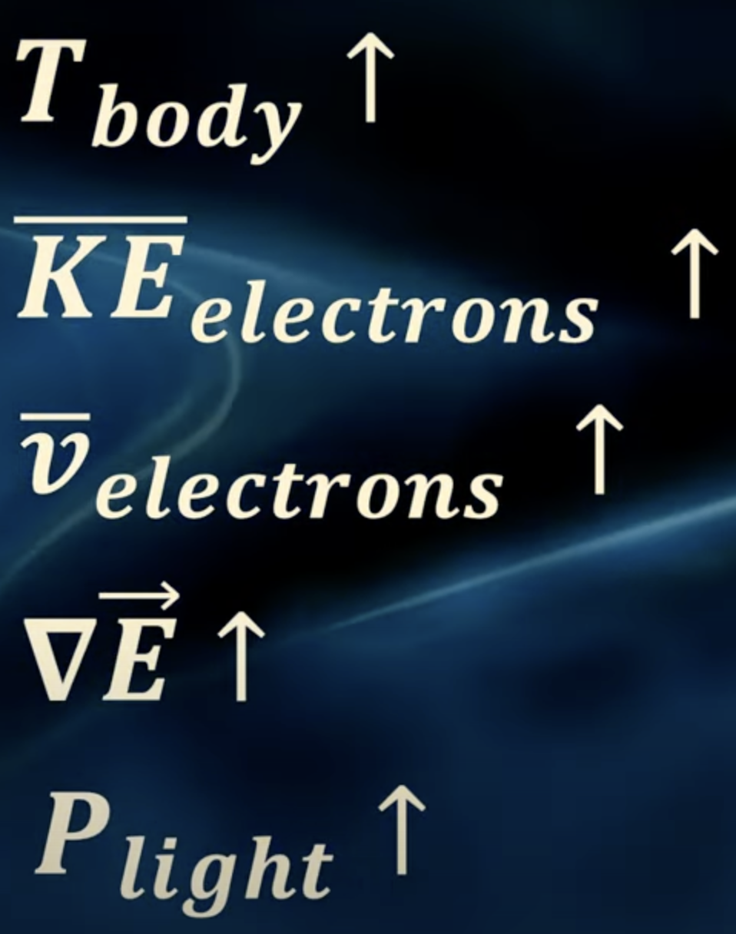
Stefan-Boltzmann's Law
/\ /\
=( ´ •⁠ω• ⁠)=
/ ͡ ︵\
(⁠人_____づ_づ

Slide 33
Black, Grey, and White Body
/ᐠ≽꩜ ᯅ ꩜≼マ
Emissivity(e): shows how close the physical behaviour of a grey body compares to that of a black body
Black Body
Grey Body
If e=1 → Ideal Black Body
If e=0 → Ideal White Body
If 0<e<1 → Grey Body

Slide 34
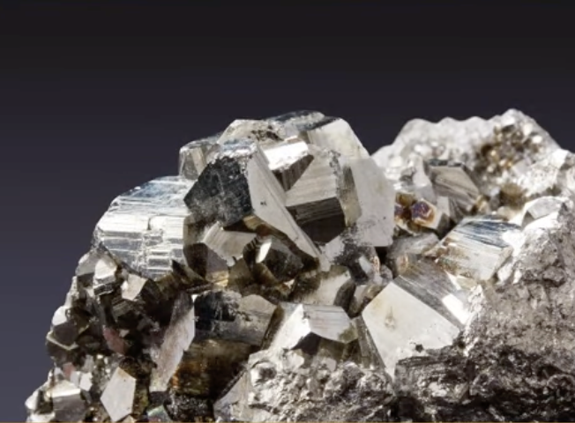
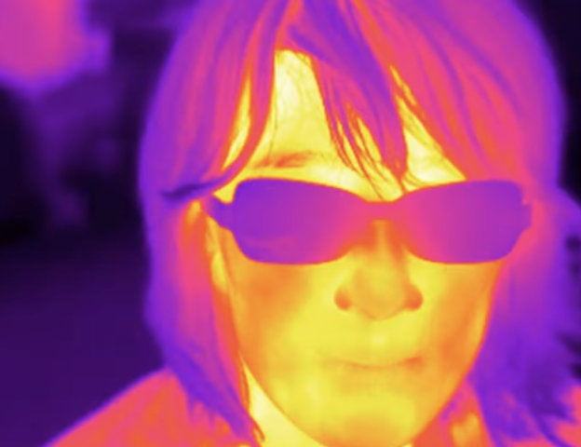
Applications in real life
/\_/\ /\_/\
=( o.o)= =(0.0⸝⸝ )=
ʕ( ა૮) (ა૮ )ʔ
Grey Body of e=0.97
Temperature=37 degree C
P=eaAT^4=810W
Infrared radiation
Aluminum e=0.05
Perfect reflectors
Aluminum coating → Mirrors

Slide 35
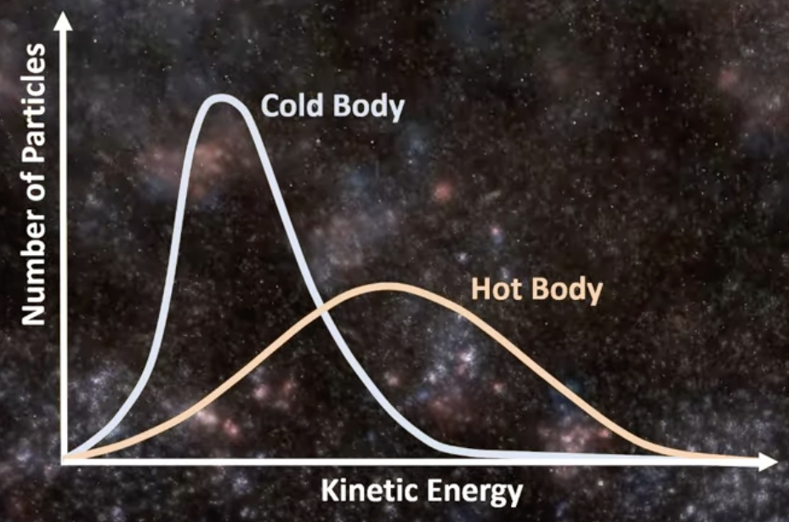
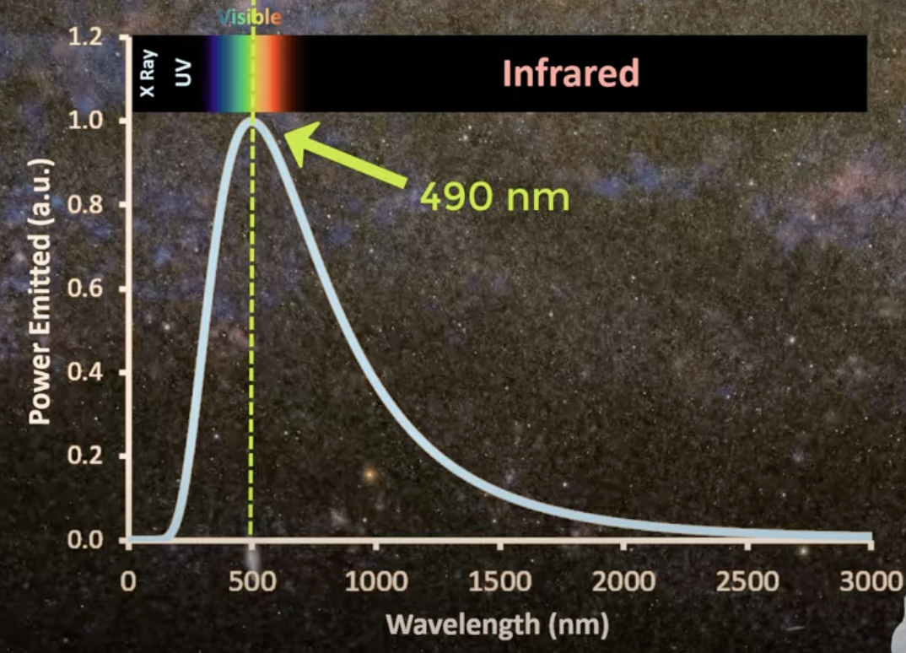
Black Body Spectrum
Black Body Spectrum of surface of the sun
How much energy is emitted each second by a black body heated at a given temperature for a specific wavelength
/ᐠ - ⩊ -マ⁩

Slide 36
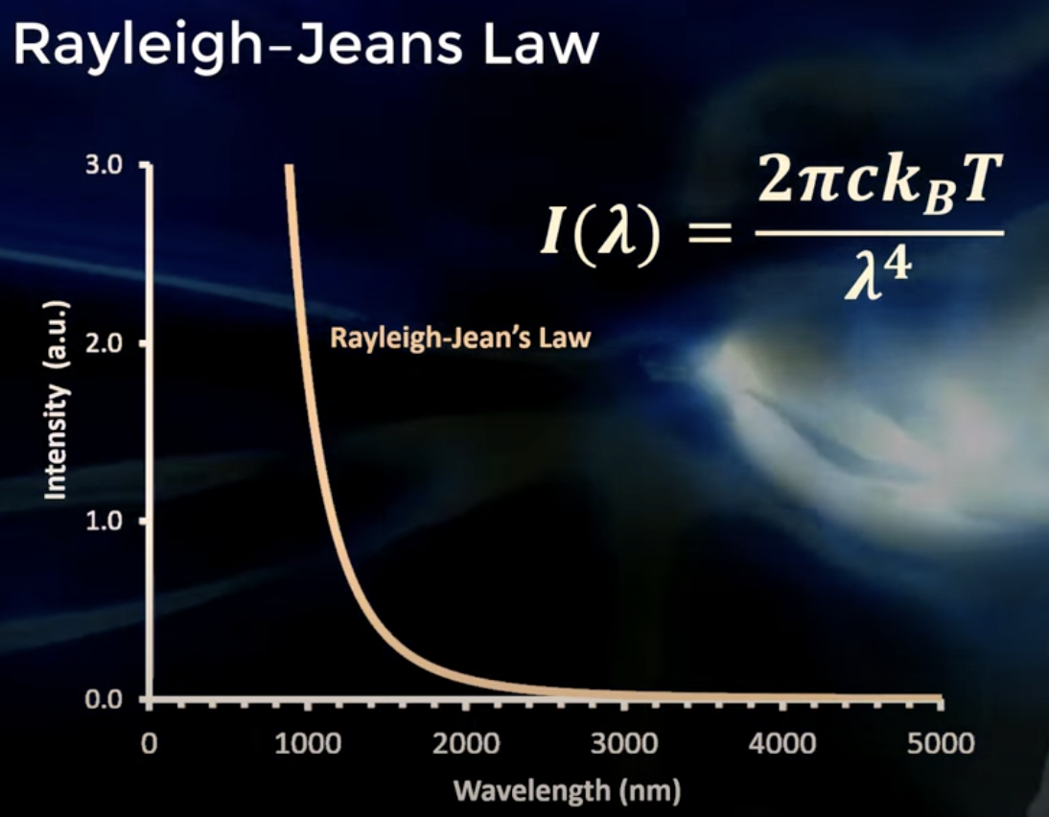
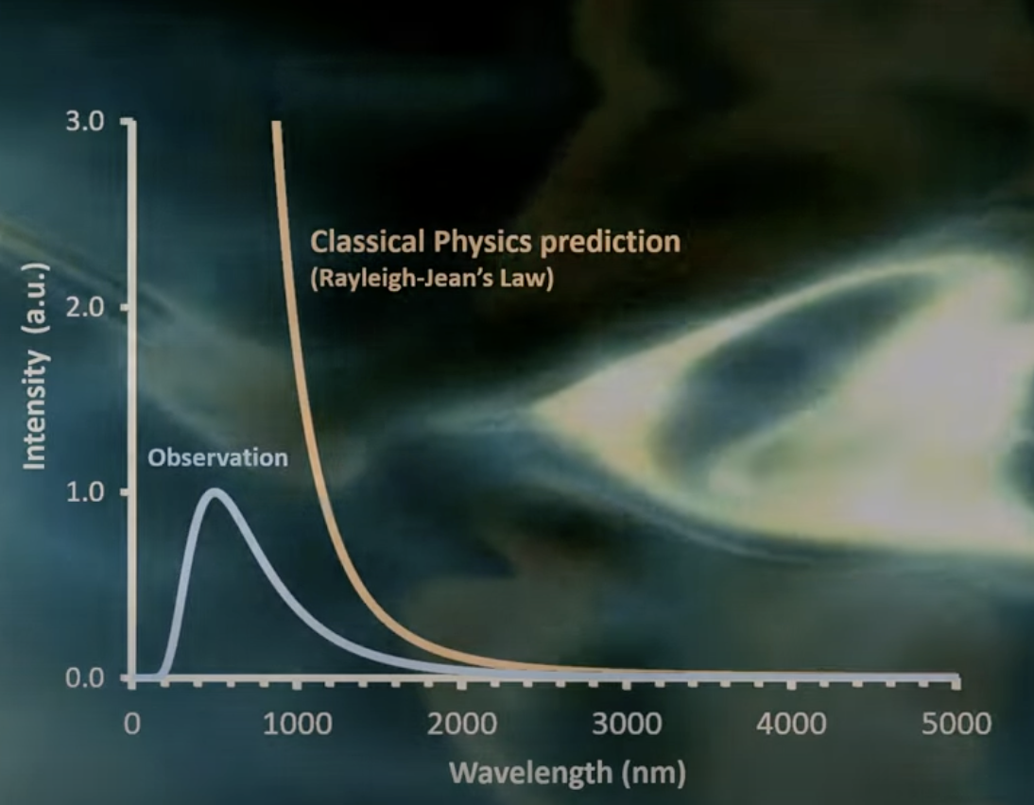
Ultraviolet Catastrophe
/ᐠﹷ ‸ ﹷ ᐟ\ﾉ
H: Planck’s constant
V: frequency of radiation
C: speed of light
Kb: Boltzmann constant
T: temperature of black body
Planck’s hypothesis of quantized radiation not only got rid of the problem of the infinity, but also correctly predicted the shape of the power curve as a function of temperature.

Slide 37
Quantum Communication and Encryption (QKD)
/\___/\
꒰ ˶• ༝ - ˶꒱
./づ~ 🍪
QKD Quantum Key Distribution: A new protocol that enables completely secure exchange of keys (to encrypt and decrypt). It usually involves photons. Different to traditional internet protocols, this completely prevents eavesdropping, as any attempt might change the quantum states of the transmitted photon and get detected. The key itself is constantly refreshed by the quantum states, making it impossible to intercept the exact key to decrypt the message. This encrypted communication is based on physical laws instead of computational complexity. There are already applications of QKD, especially in classified communication within government agencies. Various protocols are developed and used, including BB84, E91, COW, etc.

Slide 38
Quantum Communication and Encryption (PQC)
PQC Post-Quantum Cryptography: With the assistance of quantum computers, various traditional protocols and encryption become insecure. PQC is developed as a normal coding to resist quantum computer hacks. Different to QKD, PQC is accessible to everyone and all computers. This usually involves encryption based on hard mathematical problems that both traditional computers and quantum computers are unable to solve. Quantum random generators can also be used for secure key generation, with true randomness that is unpredictable.
へ.🎀
（ . ˕ . )
|、⁻〵
じしˍ,)ノ

Slide 39
Cats ᓚᘏᗢ
Poppy
Casper
Slurpee
Mimi (GATO)
Black
Rat
Cherry

Slide 40
Sources
／＞-🌱-フ
| _ _l
／` ミ＿xノ
/ |
/ ヽ ﾉ
／￣| | | |
| (￣ヽ＿_ヽ__) _)
＼二つ
Time Reimagined: Unlocking the Quantum Secrets of Next-Gen Atomic Clocks (scitechdaily.com)
Quantum mechanics explains efficiency of photosynthesis (phys.org)
https://www.youtube.com/watch?v=9DnnxvS6BBQ
https://scholar.harvard.edu/files/david-morin/files/waves_quantum.pdf
https://www.youtube.com/watch?v=ugsvADj1wts
https://www.youtube.com/watch?v=EWqzg0iqNtw
https://uwaterloo.ca/institute-for-quantum-computing/quantum-101/quantum-applications-today#mri

