Slide 1
The Formation and Characteristics of The Quark Gluon Plasma
Topic4, group members: Cheng Ma, Ke Li, Jiahua Qu, Jiayi Zhang

Slide 2
What Is QGP

Slide 3
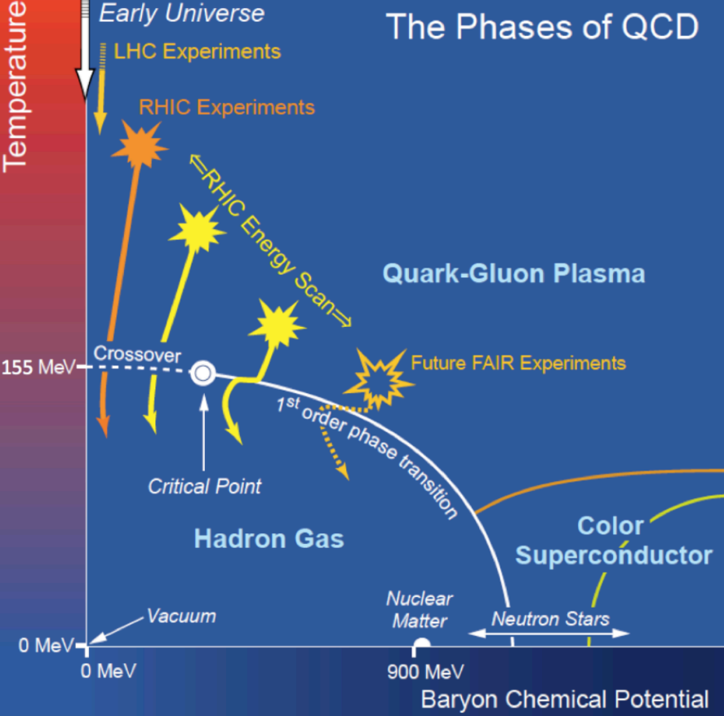
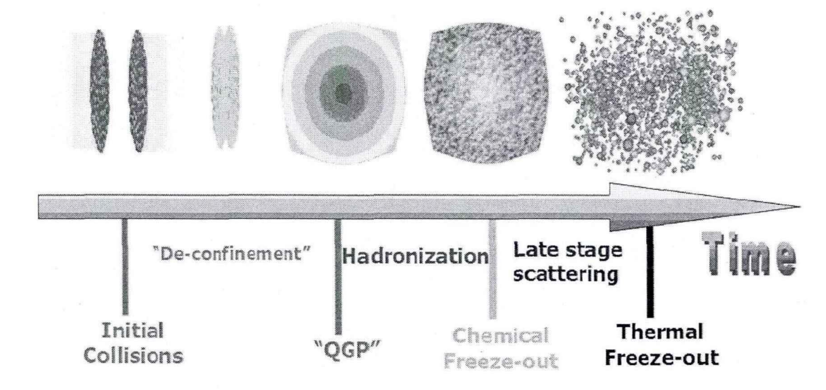
The Quark Gluon Plasma (QGP) State
The matter state, quark gluon plasma, was extensively in presence around 10^-6 seconds after the big bang.
High energy density + high temperature allows quarks to drift away from each other without being tied by the strong force generated by gluons.
For now, we can recreate the QGP state by striking nuclei through the accelerators and colliders.

Slide 4
The Formation of QGP
(Near light speed through accelerator) neuclei - neuclei collision
Striking each other, kinetic energy converts into thermal energy
Attain boundary conditions: enough energy density and temperature.
QGP is formed.
QGP scatters due to the initial movement energy density declines and quarks rebound with each other.
Non-central Collision diagram

Slide 5
The Perfect Fluid
The shear viscosity and the geometric shape

Slide 6
When detected by the detector
$Δφ$: the difference between the azimuthal angles of the chosen pair of particles
$Δη$: the difference between the pseudorapidity (which is almost equivalent to the polar angle)
$p_{t}$: the magnitude of the particle’s momentum in xoy plane
$v_{2}$: the flow’s eccentricity (how much its
geometric shape resembles an ellipse )
$v_{3}$: the flow’s triangularity (how much its
geometric shape resembles a triangle)
When the Plasma Occurs
$ε_{2}$: the flow’s eccentricity (how much its
geometric shape resembles an ellipse )
$ε_{3}$: the flow’s triangularity (how much its
geometric shape resembles a triangle)
Hydrodynamic Equation (Containing a term $\frac{η_{s}}{S}$)

Slide 7
When the Plasma Occurs
$ε_{2}$ and $ε_{3}$

Slide 8
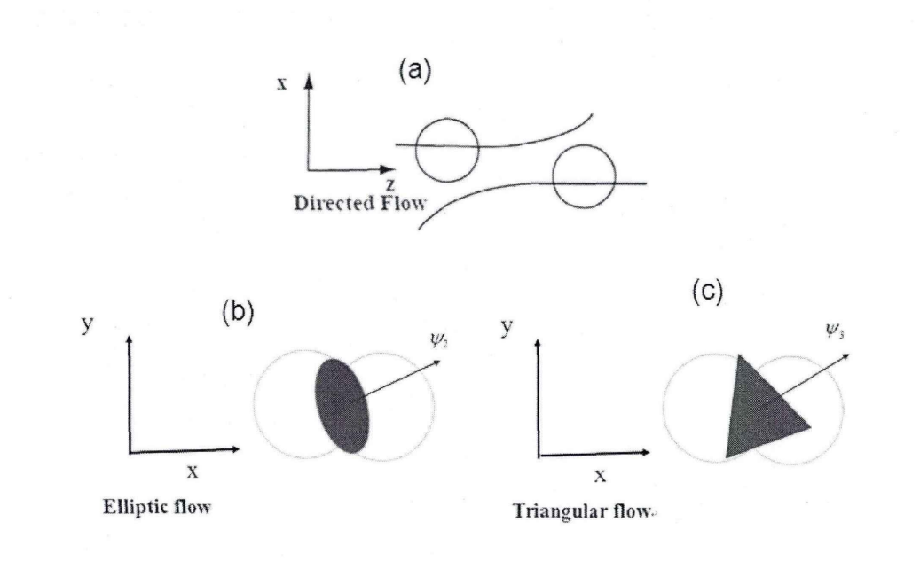
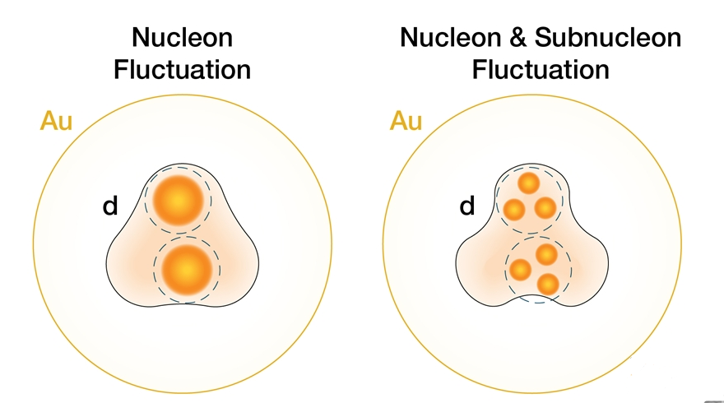
$ε$ and Fluctuation
$ε_{2}$ and $ε_{3}$
They represents the eccentricity and triangularity of the collective flow which can consequently be used to calculate the 2nd and 3rd Fourier coefficient v2 and v3 that describes the elliptic flow and triangular flow.
Fluctuation
The unevenly distributed density within the spatial coordinate: It creates pressure gradient which promotes the QGP to expand after the collision.
After the collision, QGP starts to expand and hadronization happens, since the energy density goes down. The emitted particles present the anisotropic flow characteristic.
Directed flow, elliptic flow and triangular flow
Contribution of fluctuation to anisotropic flow

Slide 9
When detected by the detector
$$Δφ, Δη,v_{2}, v_{3}$$

Slide 10
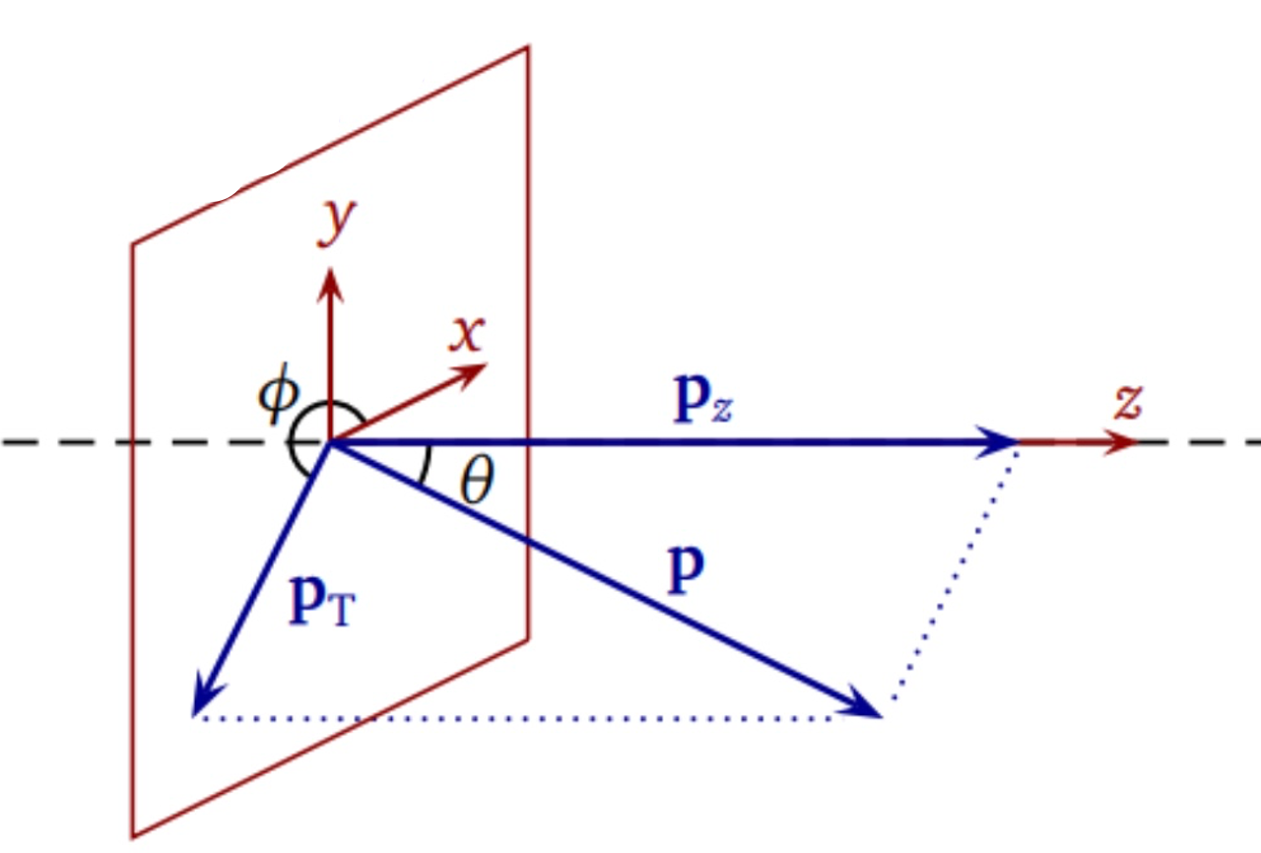
Coordinates
The final momentum of the detected particles can be expressed as:
$\vec{P}=\left(p_{x}, p_{y}, p_{z}\right)=(p_{t}, η, φ)$
$$η=−ln⁡(\tan{\frac{θ}{2}})$$
$p_{t}$: transverse momentum
$η$: pseudorapidity
$φ$: The angle between Pt and x-axis

Slide 11
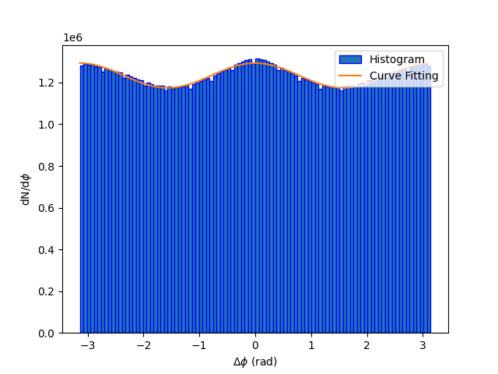
$v_{2}$ and $v_{3}$
$v_{2}$and $v_{3}$ are statistical results obtained by the following equation:
$$\frac{dN^{pairs}}{dΔφ}=N^{pair}(1+2v_{2}^{2}\cos\left(2Δφ\right)+2v_{3}^{2}cos⁡(3Δφ))$$
Incidentally, we could find that
$v_{2}∝ε_{2}$ and $v_{3}∝ε_{3}$

Slide 12
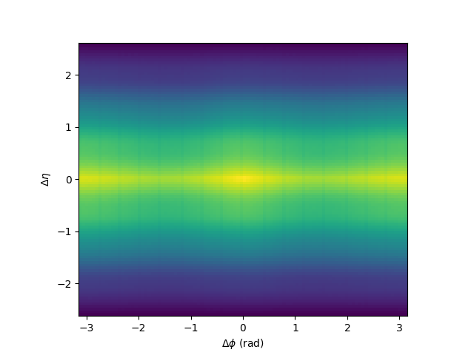
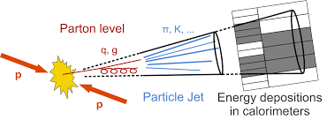
The Jets created during the collision
Jets can be considered as the tracks of the particles emitted during the collision that have similar direction.
We select |Δη| > 1 in order to eliminate the non-flow effect brought by the part at which |Δη| < 1.
When |Δη| < 1, the RHIC will produce a lot of jets (the clusters of particles that have the similar azimuth) that contributes to the final anisotropy.

Slide 13
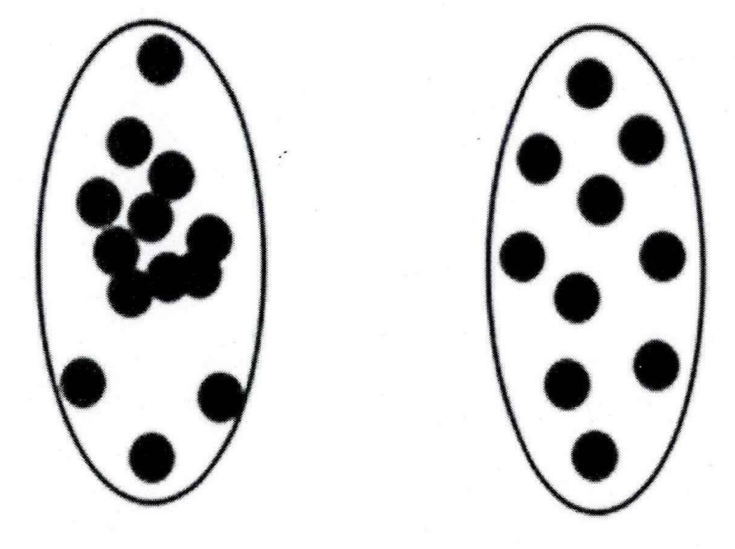
Fluctuation and $v_{2}, v_{3}$
When the two nucleons are moving along the beam axis, non central collision may occur, which creates non-symmetric pressure gradient. The pressure gradient along the minor axis of the ellipse is greater than the pressure gradient along the major axis.
As the particles’ interaction goes on, the spacial anisotropy converts into the final anisotropic within the momentum space. Such circumstance is called the anisotropic elliptic flow.
The uneven distribution of the particle density causes the configurational fluctuation, which brings possibility for the collision to form a triangular flow.
Because the minor axis of the triangle carries the most pressure
gradient, the interactions bring the uneven density gradient to the
Uneven pressure gradient which is called the anisotropic triangular
Flow.
So if the initial condition is even, there won’t be V2, V3 characters.
Initial configuration fluctuation effect

Slide 14
Perfect Fluid Property, $\frac{η_{s}}{S}$
The power due to friction is expressed as:
$$P=\frac{dE}{dt}=\frac{dE}{dS}\frac{dS}{dt}=\frac{TdS}{dt}=η_{s}{\left(\frac{∂v}{∂x}\right)}^{2}×V$$
With s=S/V we could obtain that:
$$\frac{1}{s}\frac{ds}{dt}=\frac{η}{s} {\left(\frac{∂v}{∂x}\right)}^{2}\frac{1}{T}$$
That is why when comparing the viscosity of liquids with different entropy density (such as the QGP and water), we always use the ratio $\frac{η}{s}$

Slide 15
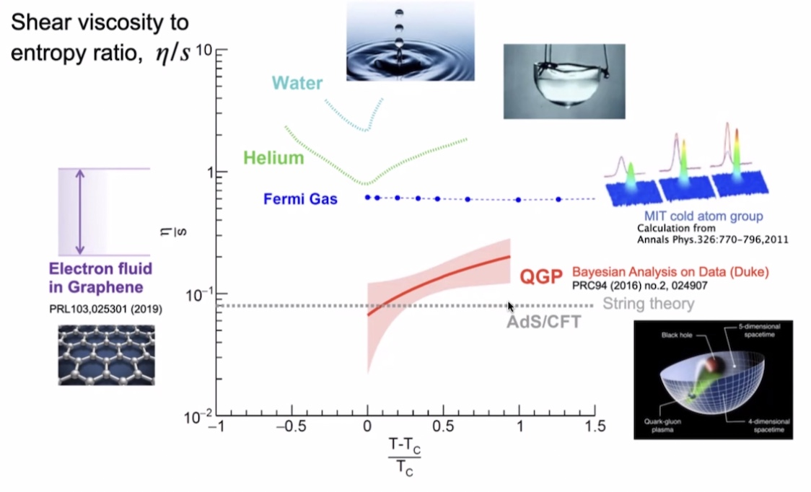
QGP And other fluids
The shear viscosity to entropy density ratio
As the KSS bound suggests:
The η/s ratio of perfect fluid is 1/4π.
The lowest measured η/s ratio of QGP
is 0.08 which is the minimum we find on
Earth, so the QGP is so called——the
perfect fluid.

Slide 16
How to find the $η_{s}/s$
Hydrodynamic Equation (Containing a term $\frac{η_{s}}{S}$)
Using different $\frac{η_{s}}{S}$, we will obtain different correlation between $p_{t},v_{2},$ $v_{3}$. We will determine $\frac{η_{s}}{S}$ by finding out which value of $\frac{η_{s}}{S}$ gives the $p_{t},v_{2}, v_{3}$ dependence that best fits with our experiments

Slide 17
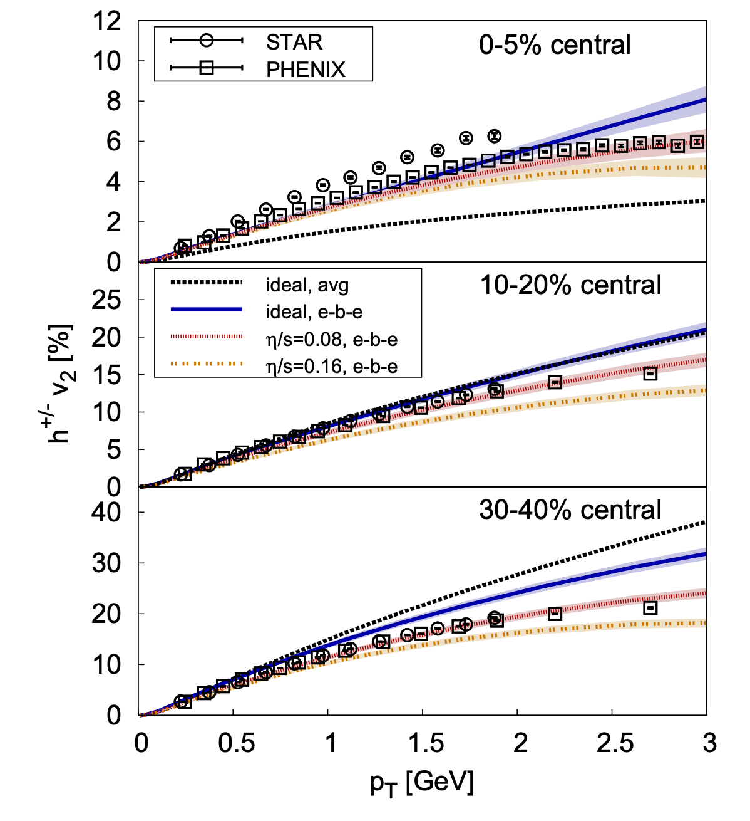
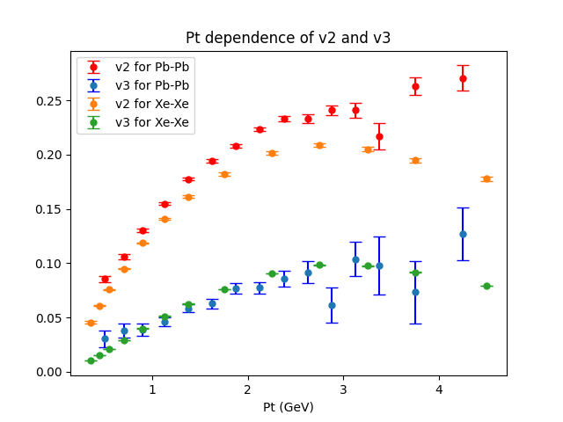
How to find the $η_{s}/s$
Correlation between $Pt$ and $v_{2}$ and $v_{3}$
Correlation between $Pt$ and $v_{2}$ for different $\frac{η_{s}}{s}$

Slide 18
Thanks for watching!

