Slide 1
Event Horizon Telescope
Team Awesome
Rebecca, Lilly, Mary, Dora, Jenny, Maggie, Andy, Charlie

Slide 2
Table of contents
01
02
Black Holes and the EHT
What EHT has observed
03
04
Future Applications
EHT and the general relativity theory

Slide 3
1.
Black holes and the EHT

Slide 4
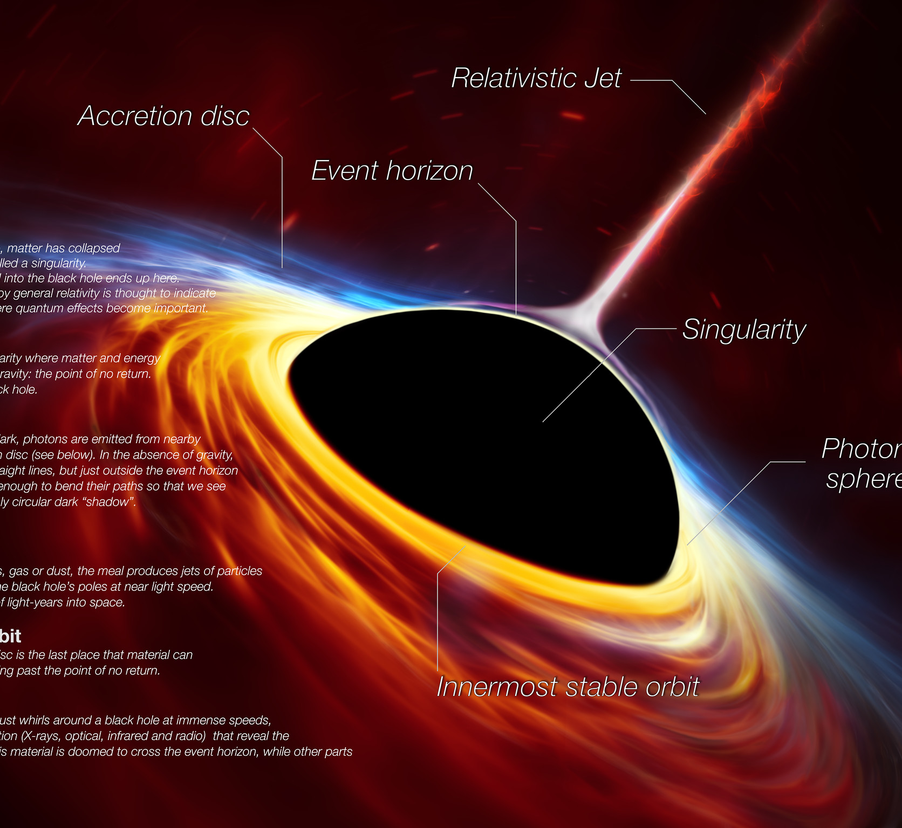
A black hole is a vacuum spacetime with its mass concentrated in an infinitesimally small region at the center
Strong gravitational field that nothing, not even light, can escape beyond its event horizon
Scientists have been studying black holes through various indirect ways

Slide 5
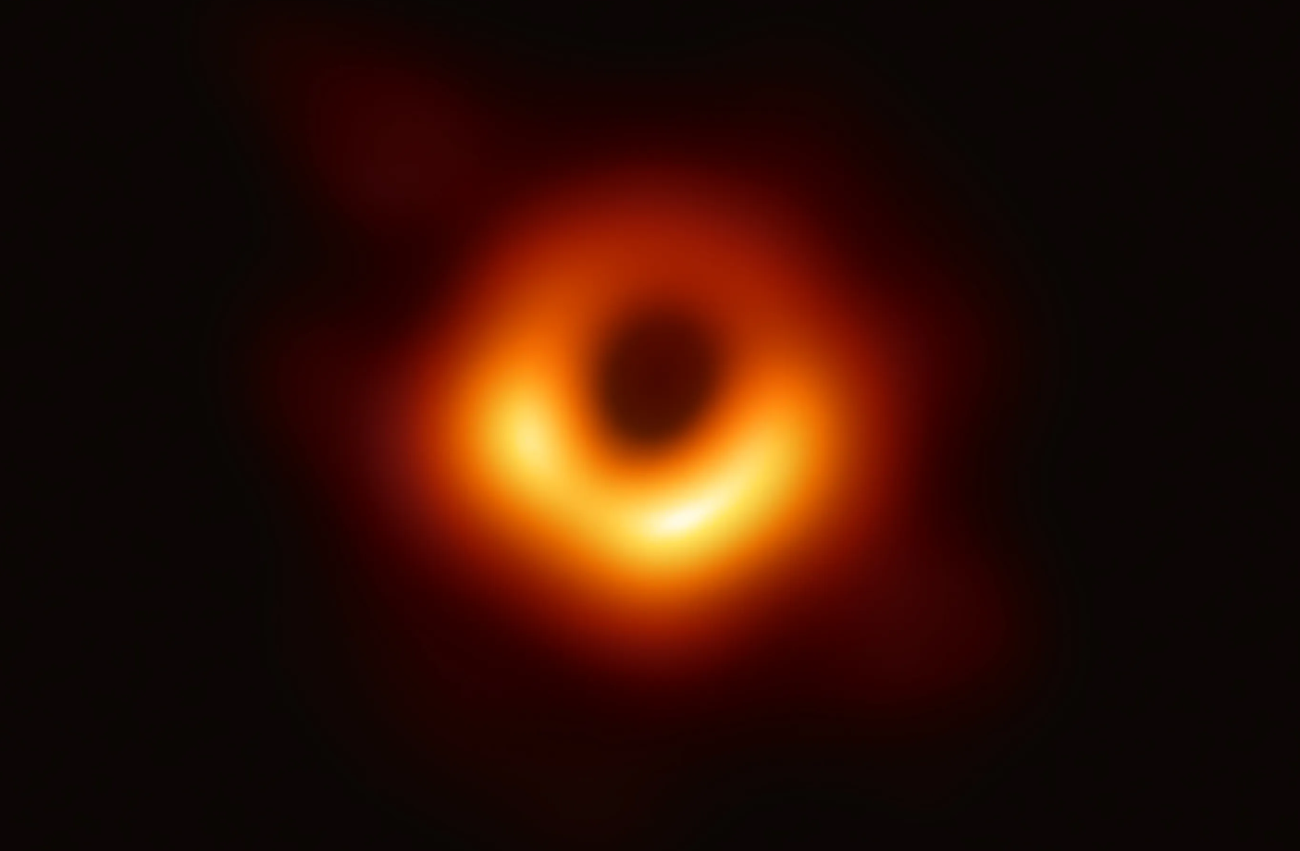
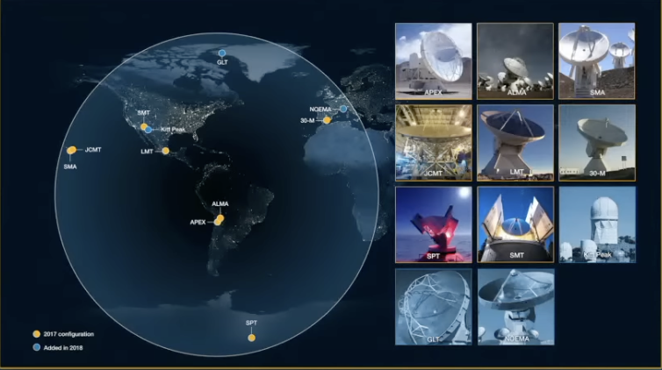

Slide 6
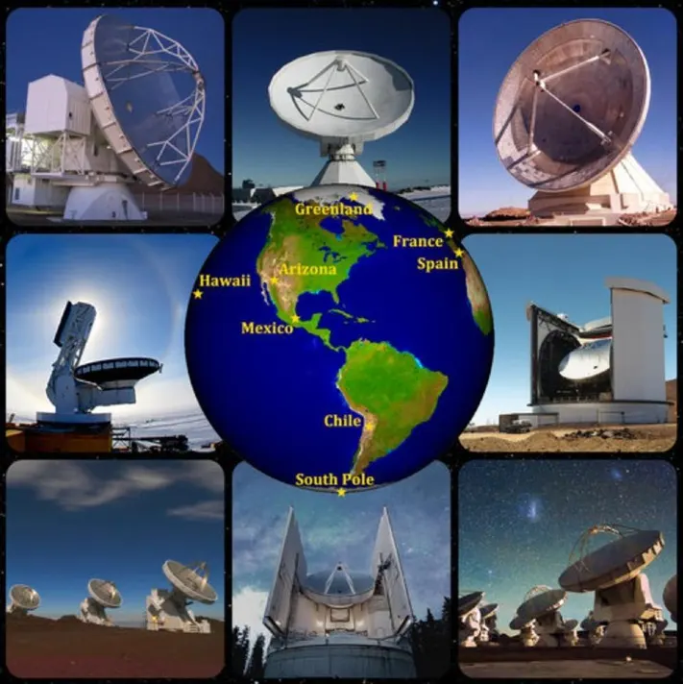
Launched in 2009 and received significant funding from multiple agencies worldwide
Head of EHT then was Sheperd S. Doeleman
8 ground based radio telescopes in 2017, 11 in 2018-2020
Apart from black hole images, also provides information about accretion disks and relativistic jets

Slide 7
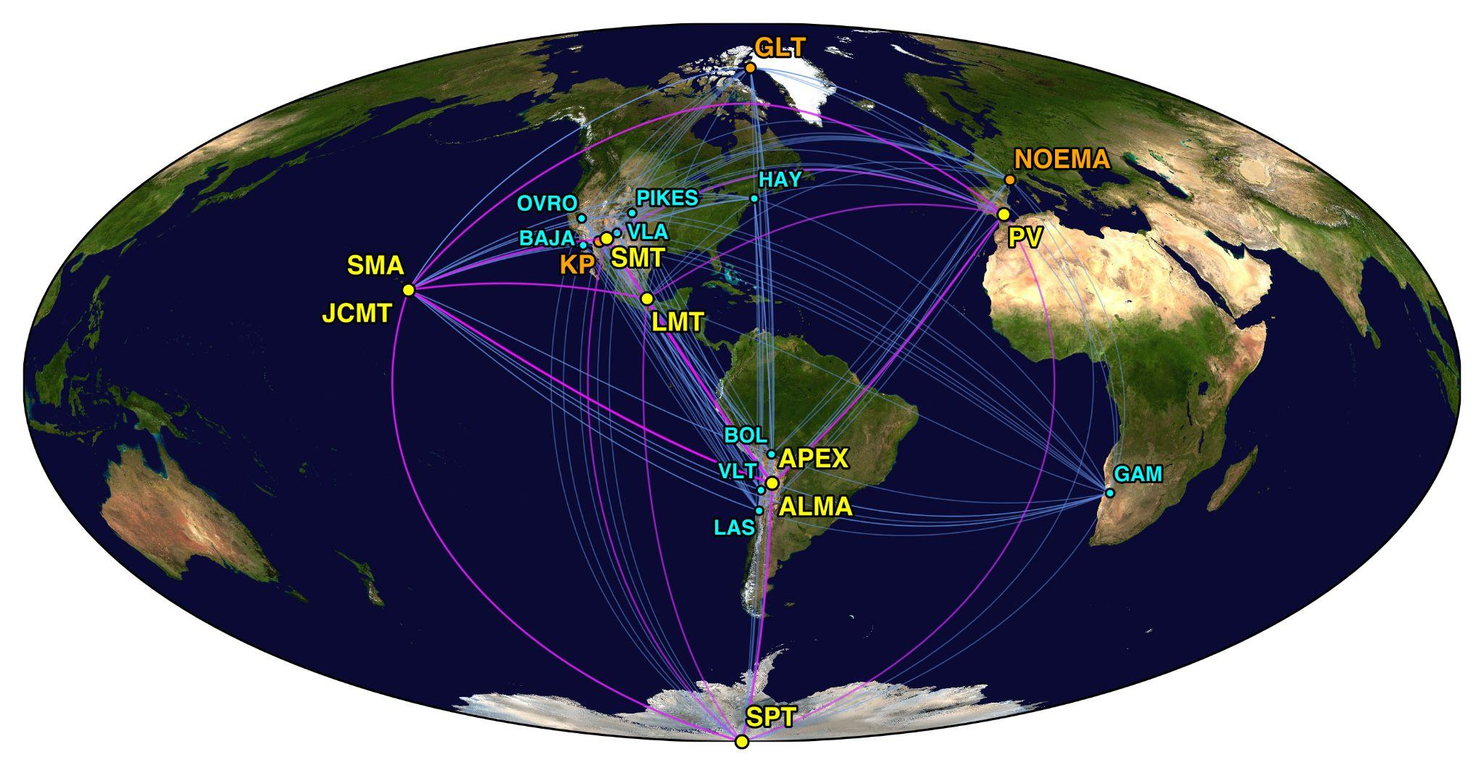
How Does the EHT Work?
-VLBI method that uses multiple telescopes across the globe that act as one big telescope using interferometry
-Each telescope collects radio waves from the event horizon and sends it as an electronic signal to the other telescopes. Astronomers turn the data into what the black hole would look like if our eyes could see in radio wavelengths.
-Use precise atomic clocks to accurately record when telescopes receive signals
-Observes at millimeter wavelength, which make it difficult for the data to process, but give a better resolution of 20 micro-arcseconds
Notes:
The Event Horizon Telescope is not just one telescope, but rather multiple telescopes around the world. They act as one big telescope with a lens the size of the earth using the Very Long Baseline Interferometry method. These telescopes can detect radio waves from far away astronomical objects. Because of the distance between the telescopes used for this project, the radio waves are collected at different times, which allows physicists to predict the structure of the source. Not only that, but the radio waves from each telescope are collected as light and put together to make one photo. The radio waves help us observe the area of space directly outside of the black hole, where hot debris is soon to enter the horizon. But where there are no radio waves, that is where we can observe the “shadow” of the black hole, where the black hole blocks light from further sources. We are able to study and observe black holes because of the EHT’s high resolution. The EHT has an angular resolution of 20 micro-arcseconds because it observes at millimeter wavelengths. The short wavelengths may make it difficult for the data to process, but they give a better resolution for the end picture.

Slide 8
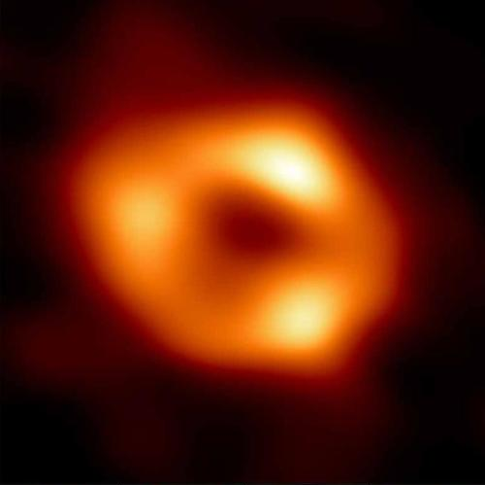
Photos made from separate telescopes are put together to create a more detailed image.

Slide 9
Effort of the scientists in EHT project
the EHT had their data of Sagittarius collected in 2017, but released the final photo in 2022
Method: interferometry, multiple telescopes in tandem
Team record the every single bit on themselves and physically transport to the MIT Haystack Observatory and the Max Planck Institute for Radio Astronomy for processing

Slide 10
Extremely High Resolutions
1
Very Long Baseline Interferometry
The EHT used a technique called Very Long Baseline Interferometry (VLBI) to achieve resolutions on the order of 20 microarcseconds, or about 2.78 x 10^(-10) degrees.
2
Short Wavelengths
By utilizing short wavelengths of around 1.3 mm, the EHT was able to take advantage of the inverse relationship between wavelength and angular resolution.
3
Global Telescope Network
Careful integration of data from a network of VLBI telescopes around the world was critical to satisfying the need for such high-resolution imaging.

Slide 11
Synchronizing Telescopes Worldwide
Atomic Clock Alignment
Precision Measurements
Simultaneous Observations
With telescopes scattered across the globe, up to 10,000 km apart, the EHT team had to carefully align atomic clocks using GPS to within picoseconds (10^-12 seconds).
This level of accuracy was necessary to ensure that the light-travel time differences between the telescopes were measured to within a millimeter.
Achieving this level of synchronization was critical for the telescopes to capture the same celestial event simultaneously, enabling the formation of a high-resolution image.

Slide 12
Overcoming Atmospheric Opacity
1
Atmospheric Challenges
2
Site Selection
The 1.3 mm wavelength used by the EHT is susceptible to degradation by atmospheric water vapor, which can cause opacity and degrade image quality.
To minimize the impact of weather, the EHT team carefully selected observational sites that maximized the number of clear weather periods for simultaneous image capture.
3
Intricate Data Handling
The EHT had to devise intricate methods for transporting and processing the large volumes of data generated by the observations, including shipping data physically via plane or ship.

Slide 13
Analyzing Petabytes of Data
Data Transport Challenges
Computational Complexity
Collaborative Effort
The EHT observations generated about a petabyte of data, which had to be transported physically due to internet bandwidth limitations.
Analyzing such large volumes of data required advanced algorithms and powerful hardware to process the varied and time-variable signals from targets like Sagittarius A*.
The EHT project involved a global team of scientists and engineers working together to overcome these immense technical challenges and produce the first-ever image of a black hole.

Slide 14
2.
What EHT has observed

Slide 15
First Image of a Black Hole: Messier 87
singularity
photon orbit
April 10, 2019
Notes:
“Only two black holes have been captured in images, both from the Event Horizon Telescope: Messier 87 and Sagittarius A* (“a star”). Messier 87 is a distant elliptical galaxy. The black hole at the center is approximately 6.5 billion times the mass of Earth’s sun. The galaxy was first discovered in 1781 by Charles Messier and is 54 million light-years away. The black hole at the center was the first to be photographed. The image was revealed in April of 2019.”
Photon orbit is the area where light could escape if it were reflected by something
We can’t see the event horizon because the light is not visible
Singularity is somewhere in the dark spot

Slide 16
Second Image of a Black Hole:
Sagittarius A*
March 2022
singularity
photon orbit
Notes:
The second black hole to be photographed is Sagittarius A*, the black hole at the center of the Milky Way Galaxy. Sagittarius A* was first discovered to be a “galactic center compact radio source” in 1974 and was theorized to be a black hole for decades until 2018 when scientists in Europe observed the behavior of hot gas clumps near Sagittarius A*. The behavior matched what was expected of hot spots near black holes. The image was first revealed in March of 2022.

Slide 17
EHT V.S. James Webb
Space Telescope
Observation Range:
JWST: Close to infrared waves (μm), resolution 0.1 arcseconds (1/3600 of a degree)
EHT: Radio waves (mm), resolution 0.000025 arcseconds
EHT can see 4000 times clearer than JWST.
Notes:
The resolution of the EHT is amazingly sharp. To compare it with other telescopes, the Jame Webb Telescope mainly observes range close to infrared waves, and has a resolution of roughly 0.1 arcsecond (1/3600 of a degree), while the EHT observes near the radio range (which has a way shorter wavelength) with a resolution of 0.000025 arcseconds. In other words, the EHT can see 4000 clearer than the James Webb Telescope.
Black holes have very small angular diameters, the biggest one we can find has a shadow that substends around 50 microarcsecond. If we want to image the shadows of these larger black holes, we would need to work in the millimeter range. That range is precisely where the EHT observes. But then we would need a telescope with the diameter of the Earth, which is not practical. So, we adopted a technique called aperture synthesis interferometry, which basically puts telescopes across the world, and then combines the images from each of those telescopes together to get a full image of what we observed. This combined power is what allows the EHT capable of taking a picture of the tiny black hole in the vast galaxy.

Slide 18
EHT V.S. James Webb
Space Telescope
Manner of Operation:
JWST: By itself, 1.5 million kilometers from Earth
EHT: Synthesizes (using supercomputer) the data gathered from an array of observatories located worldwide; together these observatories are equivalent to a giant observatory the size of the Earth
Notes:
The resolution of the EHT is amazingly sharp. To compare it with other telescopes, the Jame Webb Telescope mainly observes range close to infrared waves, and has a resolution of roughly 0.1 arcsecond (1/3600 of a degree), while the EHT observes near the radio range (which has a way shorter wavelength) with a resolution of 0.000025 arcseconds. In other words, the EHT can see 4000 clearer than the James Webb Telescope.
Black holes have very small angular diameters, the biggest one we can find has a shadow that substends around 50 microarcsecond. If we want to image the shadows of these larger black holes, we would need to work in the millimeter range. That range is precisely where the EHT observes. But then we would need a telescope with the diameter of the Earth, which is not practical. So, we adopted a technique called aperture synthesis interferometry, which basically puts telescopes across the world, and then combines the images from each of those telescopes together to get a full image of what we observed. This combined power is what allows the EHT capable of taking a picture of the tiny black hole in the vast galaxy.

Slide 19
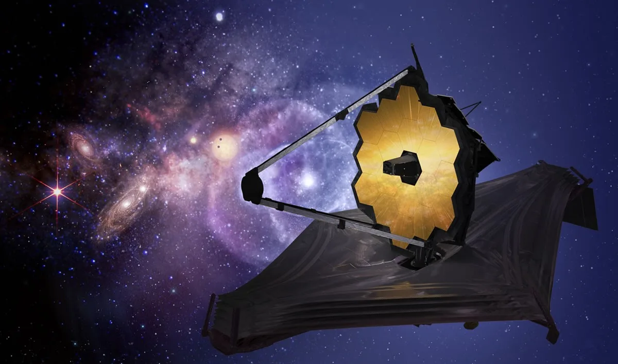
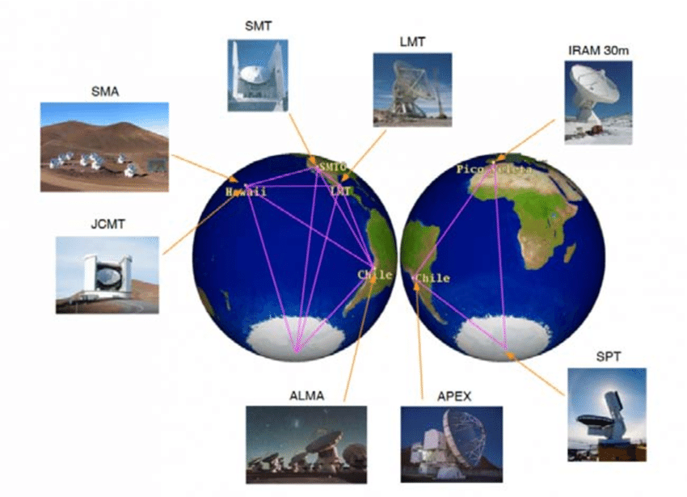
EHT V.S. James Webb
Space Telescope
Notes:
The resolution of the EHT is amazingly sharp. To compare it with other telescopes, the Jame Webb Telescope mainly observes range close to infrared waves, and has a resolution of roughly 0.1 arcsecond (1/3600 of a degree), while the EHT observes near the radio range (which has a way shorter wavelength) with a resolution of 0.000025 arcseconds. In other words, the EHT can see 4000 clearer than the James Webb Telescope.
Black holes have very small angular diameters, the biggest one we can find has a shadow that substends around 50 microarcsecond. If we want to image the shadows of these larger black holes, we would need to work in the millimeter range. That range is precisely where the EHT observes. But then we would need a telescope with the diameter of the Earth, which is not practical. So, we adopted a technique called aperture synthesis interferometry, which basically puts telescopes across the world, and then combines the images from each of those telescopes together to get a full image of what we observed. This combined power is what allows the EHT capable of taking a picture of the tiny black hole in the vast galaxy.

Slide 20
03
EHT and the general relativity theory

Slide 21
How does the image taken by EHT prove the accuracy of General Relativity
Shadow Size
Shadow of a Black Hole: created by the gravitational bending of light near the Black Hole, and it’s larger than the Event Horizon because it also includes the area where light is absorbed into the Black Hole or bent away from the observer.

Slide 22
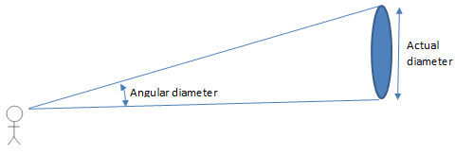
Plugging in G, M, and C
Converting to Angular Size (Angular Diameter)
The size of the shadow observed using EHT is around 42 microarcseconds, which is really close to the angle predicted by general relativity
distance
The distance to M87* is approximately 55 million light years

Slide 23
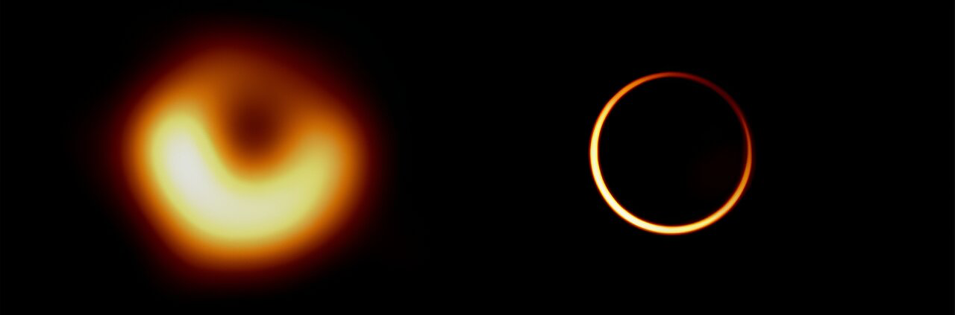
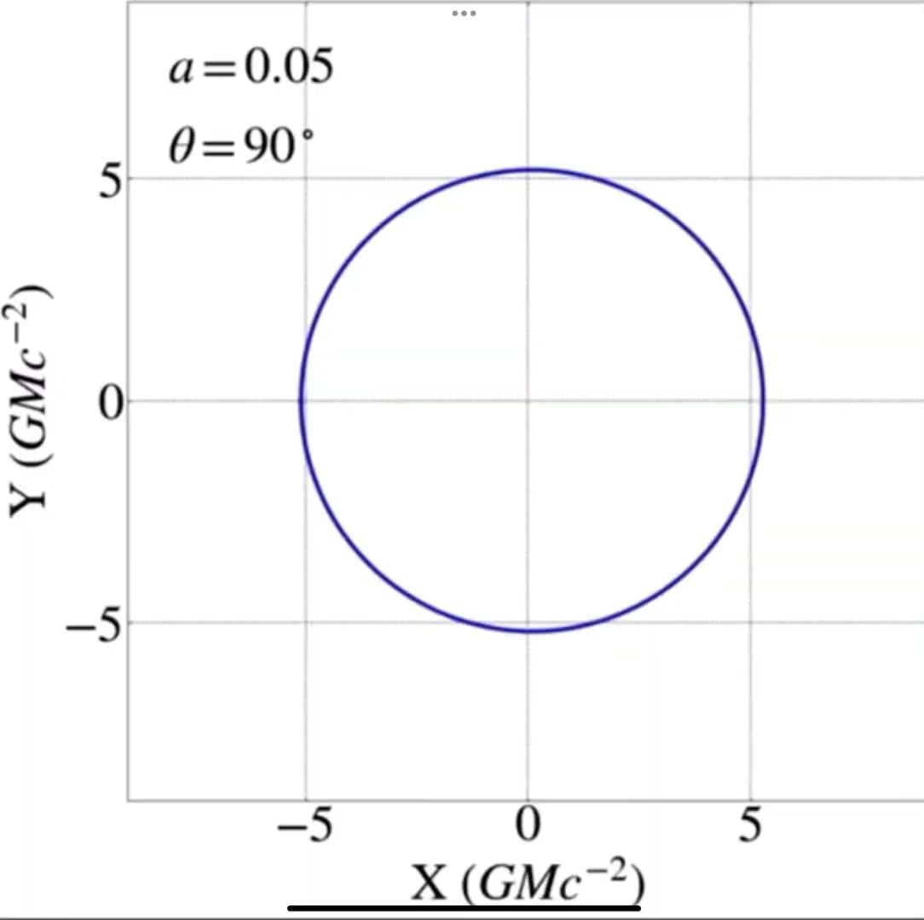
How does the image taken by EHT proved the accuracy of General Relativity
Shadow Shape
Brightness Asymmetry
According to the General Relativity Theory, a Kerr black hole’s shadow should have a roughly circular shape.
The real image of black hole in M87* shows a nearly perfect circular shape

Slide 24
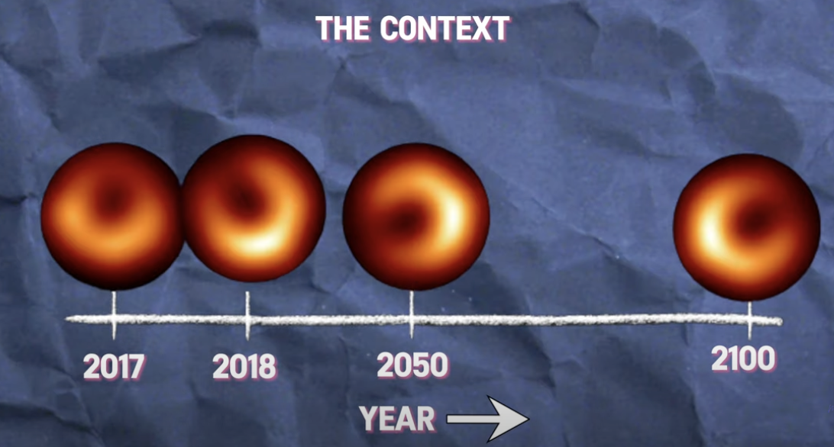
How does the image taken by EHT proved the accuracy of General Relativity
The radius of a black hole is strongly dependent on only one quality: its mass

Slide 25
04
Future Applications

Slide 26
What the EHT could do in the future
Refining photographs
Photographing more supermassive black holes
Finding more unknown phenomena
With the assistance of AI and quantum computation, it is likely that we can obtain more pictures and pictures with higher resolution.
Find patterns and deepen our understanding of a typical black hole
Orbiting supermassive black holes is still a very unsolved mystery
Notes:
Refining photographs:
Although the maths and physics of black holes has been thoroughly researched and proven, we still haven’t had proper physical way of verifying it in person. Refined photographs could help by confirming that all the calculations and assumptions are correct (including the photon ring, for example).
Comparing our results with what Einstein’s theory of general relativity predicts can ultimately prove or disprove the theory
As said before, the EHT is able to create higher resolution pictures than the telescopes we have had before, so it will be more useful for observing the black holes
Photographing more supermassive black holes:
Having more samples of both black holes and supermassive black holes can help us spot patterns in them, and extend our research, hinting towards phenomena that possibly can’t be figured out using maths alone, and possibly coming up with a new theory if Einstein’s is disproved. Supermassive black holes are still a big mystery as well, and finding these gigantic structures in space and how they interact with other objects will be a great step forward
For eg, the supermassive black holes in andromeda could be the next target
Finding more unknown phenomena (a bit more ambitious):
Usually, when there are two black holes near each other, they combine to form a bigger, single black hole, creating gravitational waves around them.
However, there’s the theory that two supermassive black holes that are near each other, with specific conditions, could orbit each other rather than combine. This could cause continuous gravitational waves in space time, effectively bending the supposed “fabric of space”.
Apart from that, again, learning about how supermassive black holes interact alone is a very curious topic that will be researched.

Slide 27
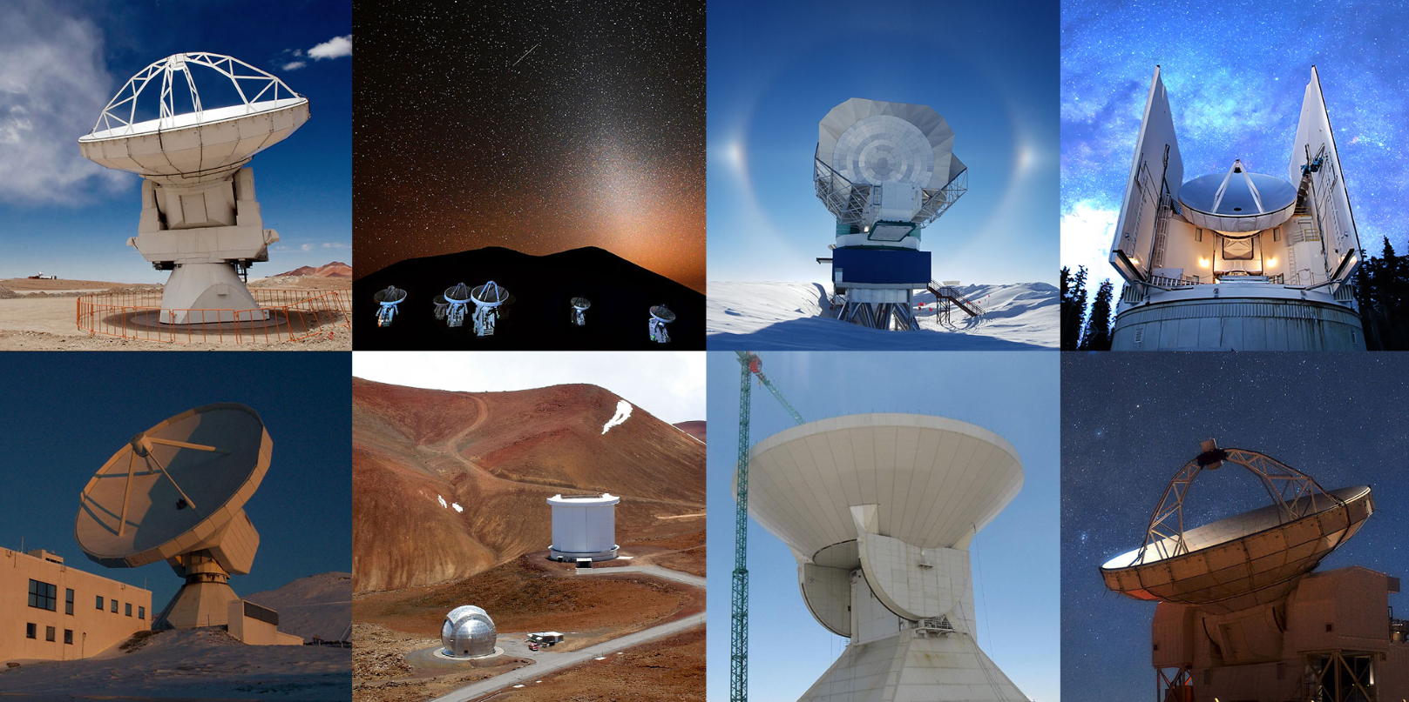
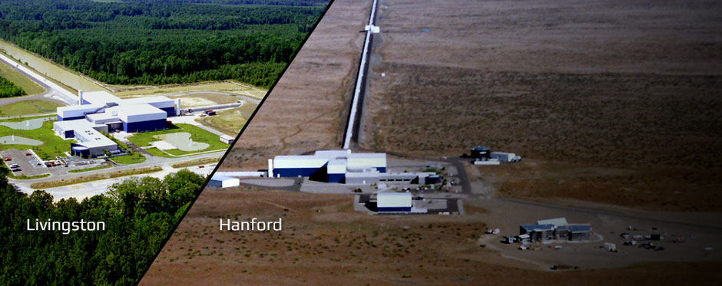
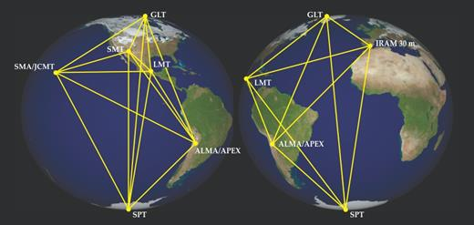
The future of interferometry
Notes:
Interferometry is when you use data from many detectors or telescopes to combine them and form a conclusion. For eg, LIGO and LISA detectors are also interferometers.
*click slide*
The EHT (an interferometer) is able to gather data from all part of the world and combine them using a supercomputer. This increases accuracy and efficiency when it comes to generating the final picture and eliminating any anomalies that may come up.
This is also seen in the LIGO detectors, where there are two of the machines in work (one in washington state and the other in louisiana), to make sure the readings are matching and reasonable.
In the future, these interferometers will most probably be more and more developed, because of its power, being able to photograph things further away and more accurately - as seen compared to the james webb telescope.
Telescopes like this could possibly be sent into space, decreasing the disturbance from the atmosphere, and increasing its size (right now it’s the size of the Earth, which is already very big, but they can always be further apart and reach for further into space), exploring all kinds of phenomena in space.

Slide 28
05
Conclusion

Slide 29
Summary
Black holes have always been difficult to observe, but by using astronomical interferometry, the EHT collaboration has discovered a way to picture them. Scientists spent half a decade on the Sagittarius A* black hole and overcomed technical problems.
The EHT has produced images of two black holes so far: Messier 87 and Sagittarius A*. The EHT observes radio waves while the JWST mainly observes the infrared wavelength, and the EHT has higher resolution.
The EHT image prove the general relativity theory from several different aspects: shadow size, shadow shape, the brightness asymmetry of the photon ring and the plasma spinning around it, and the non-changing radius-mass relationship
Interferometers are proved to be very useful, being more accurate, far reaching and clear

Slide 30
Questions?

Slide 31
Thank you for listening!

Slide 32
Bibliography
https://www.space.com/event-horizon-telescope
https://www.space.com/sagittarius-a
https://www.space.com/first-black-hole-photo-by-event-horizon-telescope.html
https://cfa.harvard.edu/facilities-technology/telescopes-instruments/event-horizon-telescope-eht#:~:text=Founded%20by%20Shep%20Doeleman%20at,of%20the%20 nearby%20galaxy%20M87.
https://eventhorizontelescope.org/
https://www.astronomy.com/science/how-did-astronomers-take-a-picture-of-our-galaxys-supermassive-black-hole/#:~:text=The%20Event%20Horizon%20Telescope%20(EHT,%2C%20on%20May%2012%2C%202022.
https://www.space.com/event-horizon-telescope.html#:~:text=JWST%20observes%20in%20the%20micrometer,4000%20sharper%20than%20the%20JWST.
https://pubs.aip.org/physicstoday/article/71/4/70/935308/Imaging-black-holesThe-Event-Horizon-Telescope
https://pubs.aip.org/physicstoday/article/71/4/70/935308/Imaging-black-holesThe-Event-Horizon-Telescope
https://www.quantamagazine.org/what-the-sight-of-a-black-hole-means-to-a-black-hole-physicist-20190410/#comments
https://www.aanda.org/articles/aa/full_html/2024/01/aa47932-23/aa47932-23.html
https://mediaenviron.org/article/88163-the-cartographic-impulse-and-its-epistemic-gains-in-the-process-of-iteratively-mapping-m87-s-black-hole

